Slide 1
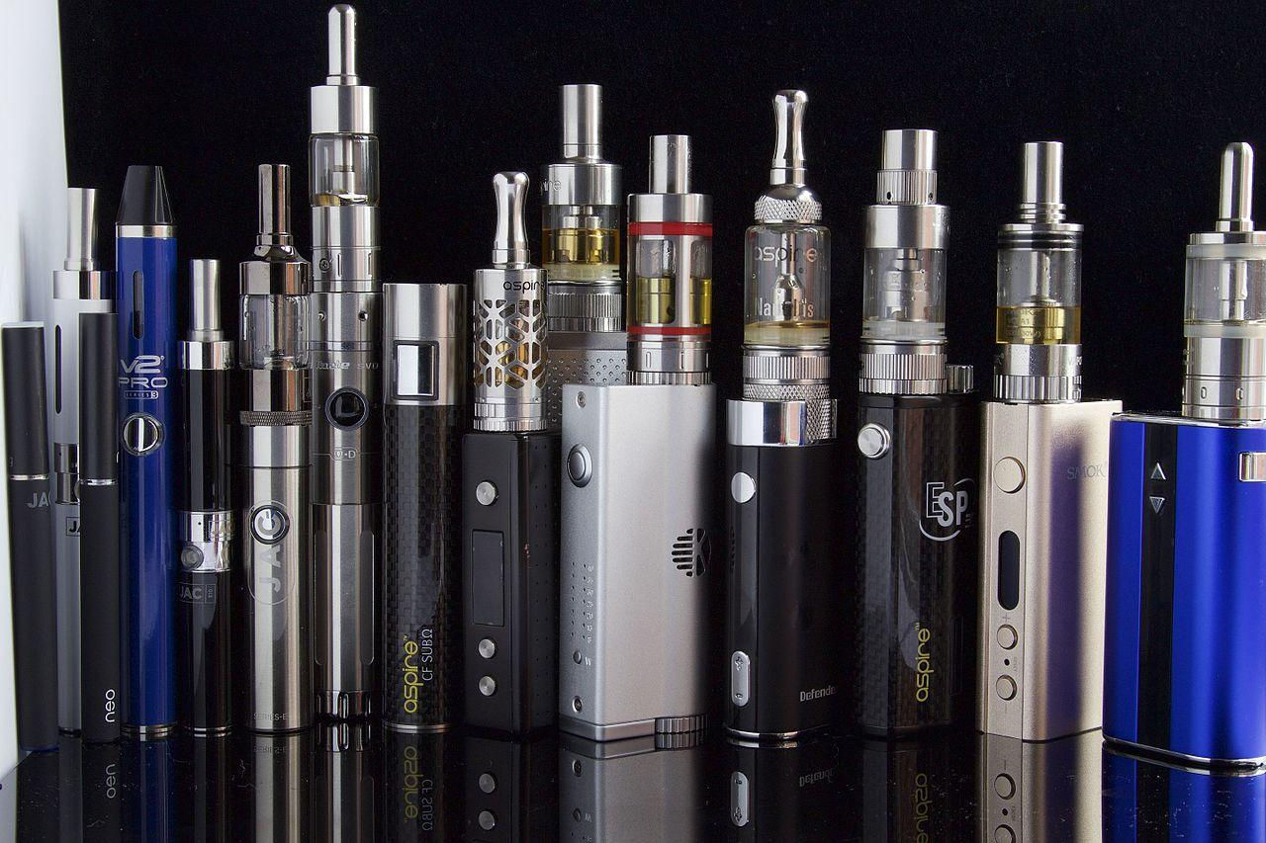
Electronic Cigarettes & Drug Use
Alexandria City Public Schools (ACPS)
Department of Student Services
Alternative Programs & Equity
Fredy L. Martinez, MS. Ed. CSAC. QMHP ACPS K-12 Substance Abuse Prevention & Intervention Services Coordinator
Notes:
Image source: CC BY-SA 2.0 - File:E Cigarettes, Ego, Vaporizers and Box Mods (17679064871).jpg Created: 5 May 2015
Image credits: https://en.wikipedia.org/wiki/Electronic_cigarette

Slide 2
Essential Questions
What's the problem about vaping?
What's the difference between smoking e-cigarettes and smoking tobacco?
What's the difference between smoke, aerosol and vapor?
Are VAPING and JUULING the same?
Is VAPING harmful? how?
Is nicotine is addictive? how?

Slide 3
7 out of 10 middle and high school students who currently use tobacco have used FLAVORED products. (Source: Mobility & Mortality Weekly Report (MMWR, CDC)
Source: https://www.flavorshookkids.org/#do-something
Notes:
Talking Points:
“we will be passing it (e hookah) around and enjoying the smell that the Vapor leaves in the air because it smells all fruity and candy and delicious” “e hookah just sounds like it's better because if you have an ecig, it’s still a cigarette in a way. Then you have a hookah, it’s kind of cool. It’s better.”
Source:
Wagnoer et al. Nicotine Tob Res. 2016. Mar 30. [Epub ahead of print]. The Triangulum, Thanks to Mary Rezk-Hanna, NP, PhD, UCLA.
Source: https://www.flavorshookkids.org/#do-something

Slide 4
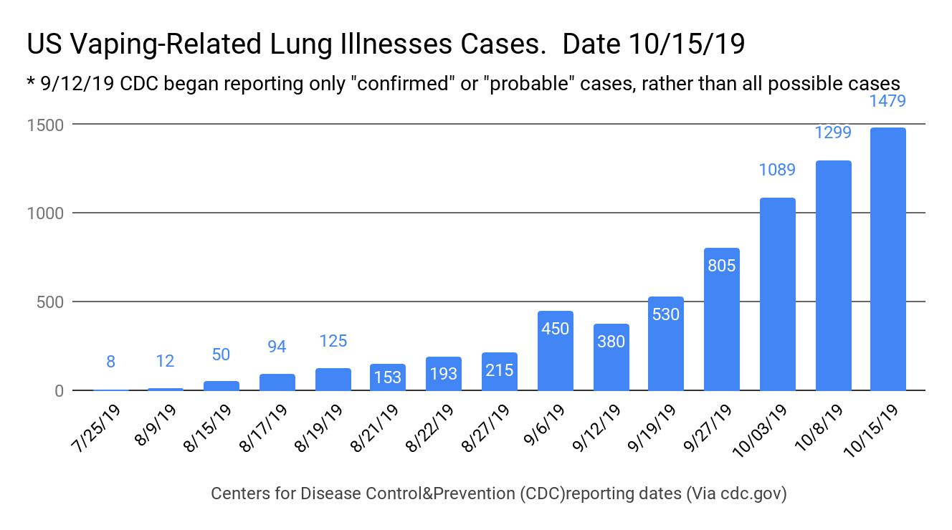
1479 lung injury cases/49 states : October 15, 2019
CDC, the U.S. Food and Drug Administration (FDA)
Notes:
Source:
https://www.cdc.gov/tobacco/basic_information/e-cigarettes/severe-lung-disease.html
https://www.buzzfeednews.com/article/danvergano/vaping-illness-outbreak-spread
https://www.buzzfeednews.com/article/danvergano/vaping-lung-illness-mystery-causes

Slide 5
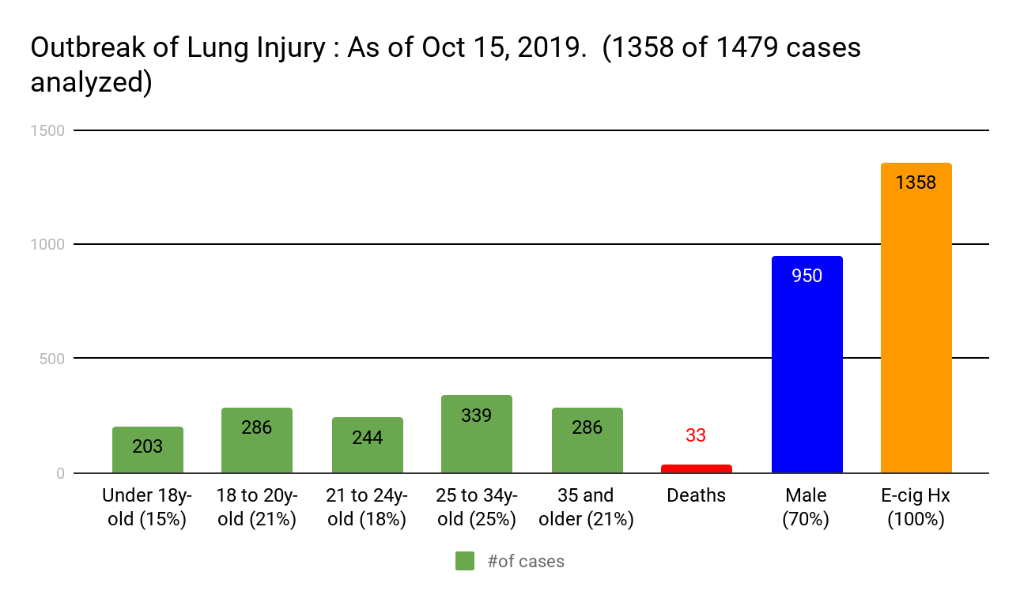
Office on Smoking and Health, National Center for Chronic Disease Prevention and Health Promotion
Source: CDC Page last reviewed: October 3, 2019. Content source:
Notes:
Source:
https://www.cdc.gov/tobacco/basic_information/e-cigarettes/severe-lung-disease.html

Slide 6
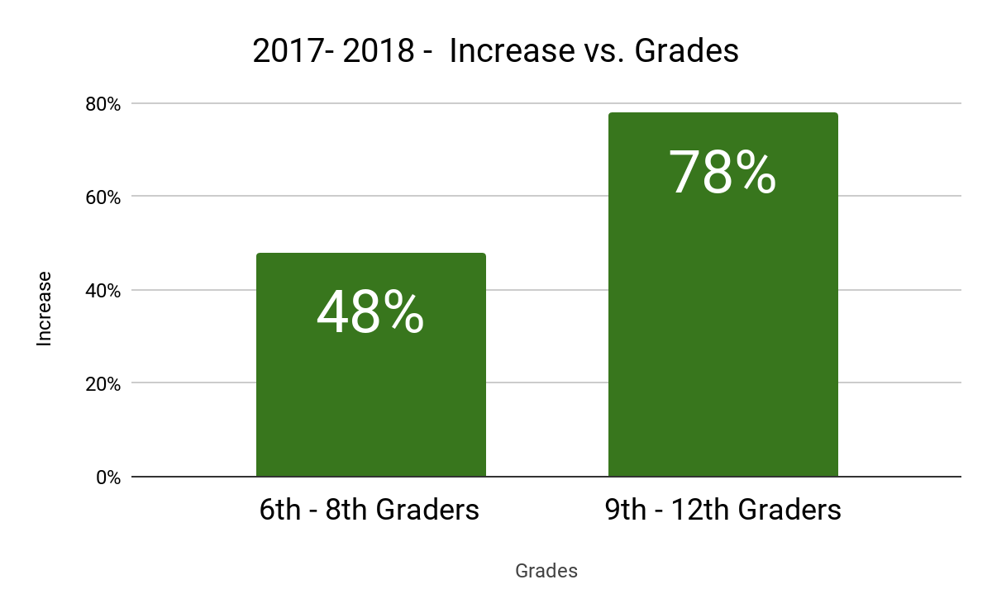
National Youth Tobacco 2018 Survey
4 out of 5 kids tobacco users started with a flavored product (American Journal of Preventive Medicine )
Surge in current e-cig use = 1.5 million more students 2017-2018
The Food and Drug Administration
updated: 05/29/2019
Notes:
Talking Points:
The National Youth Tobacco Survey (NYTS) is a correlational study
-Current e-cigs self-report use in Middle school jumped 48%
-Current e-cigs self-report use in High school jumped 78%
-E-cigarette users reported using the product more frequently than regular cigarettes.
Consist questions/self-report.
78% increase among high school students from 2017 to 2018
Source:
https://www.fda.gov/tobacco-products/youth-and-tobacco/youth-tobacco-use-results-national-youth-tobacco-survey
https://www.drugabuse.gov/related-topics/trends-statistics/infographics/monitoring-future-2018-survey-results
https://www.flavorshookkids.org/#do-something
https://www.ncbi.nlm.nih.gov/pmc/articles/PMC5522636/
Source:
The Flavor Trap Report. American Academy of Pediatrics. March 15, 2017.
Ambrose, BK, et al., “Flavored Tobacco. Product Use Among US Youth Aged 12-17. Years, 2013-2014,” Journal of the American Medical Association, published online. October 26, 2015.
Villanti, A. C., Johnson, A. L., Ambrose, B. K., Cummings, K. M., Stanton, C. A., Rose, S. W., … Hyland, A. (2017). Flavored Tobacco Product Use in Youth and Adults: Findings From the First Wave of the PATH Study (2013-2014). American journal of preventive medicine, 53(2), 139–151. doi:10.1016/j.amepre.2017.01.026

Slide 7
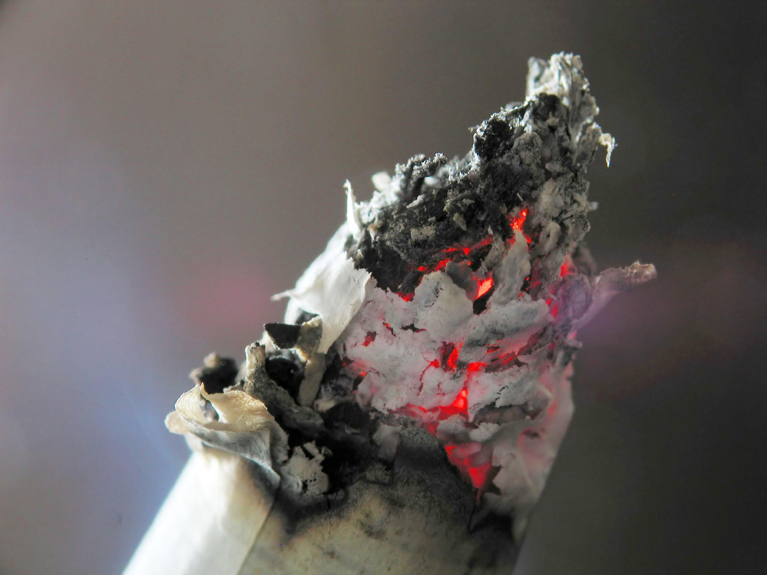
Combustion -> Smoke
Combustion of Tobacco: The tobacco in a cigarette burns at temperatures in excess of 600°C...
...generating smoke that contains high levels of harmful chemicals.
Solid state (tobacco/fuel)+oxygen+energy= Combustion/Oxidation/heat = Smoke
Source: https://www.thoughtco.com/combustion-reactions-604030
Notes:
Talking Points:
Solid state (tobacco/fuel)+oxygen+energy= Combustion/Oxidation = Smoke
“When a cigarette is lit, the combination of tobacco (fuel) and oxygen in the air generates a self-sustaining combustion process that consumes the tobacco. The combustion of tobacco results in the formation of smoke (that contains a range of chemical constituents), heat, and ash. The high heat associated with combustion leads to the thermal breakdown of the tobacco when it is burned, resulting in the production of many of the toxicants found in cigarette smoke.”
“A combustion reaction is a major class of chemical reactions, commonly referred to as "burning." Combustion usually occurs when a hydrocarbon reacts with oxygen to produce carbon dioxide and water. In the more general sense, combustion involves a reaction between any combustible material and an oxidizer to form an oxidized product. Combustion is an exothermic reaction, so it releases heat, but sometimes the reaction proceeds so slowly that a temperature change is not noticeable.”
Cigarette combustion produces approx. 7000 chemicals out of which 70 chemicals are known carcinogens (substances that produce cancer)
Here is a list of chemicals found in regular cigarettes.
https://med.stanford.edu/tobaccopreventiontoolkit/E-Cigs/ECigUnit1.html
Smoking : reduces oxygen delivery to the heart
Source:
https://www.thoughtco.com/combustion-reactions-604030
http://www.bat-science.com/groupms/sites/BAT_9GVJXS.nsf/vwPagesWebLive/DO858KZ6
Image: https://commons.wikimedia.org/wiki/File:Cigarette_ash.jpg
https://en.wikipedia.org/wiki/Smoke

Slide 8
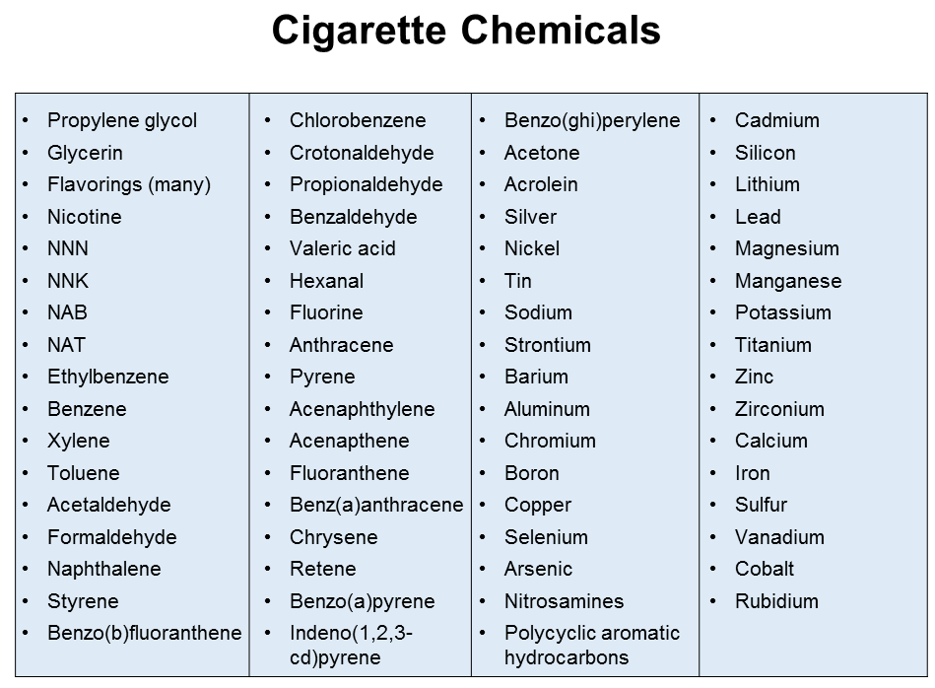
Source: Cancer.org
Stanford Medicine. Tobacco Prevention Toolkid.Stanford University, 2018
Notes:
Talking Points:
This is the list of chemicals in regular cigarettes. Scientist assess at least 4 cancer causing chemicals in regular cigarettes.
Source :
https://www.cancer.org/cancer/cancer-causes/tobacco-and-cancer/carcinogens-found-in-tobacco-products.html
https://med.stanford.edu/tobaccopreventiontoolkit/E-Cigs/ECigUnit1.html

Slide 9
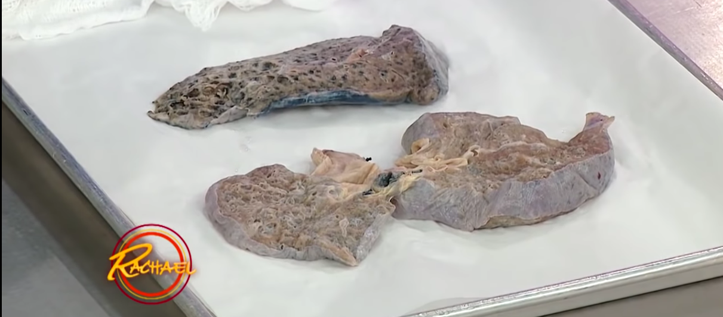
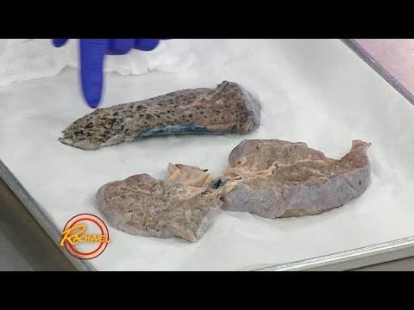
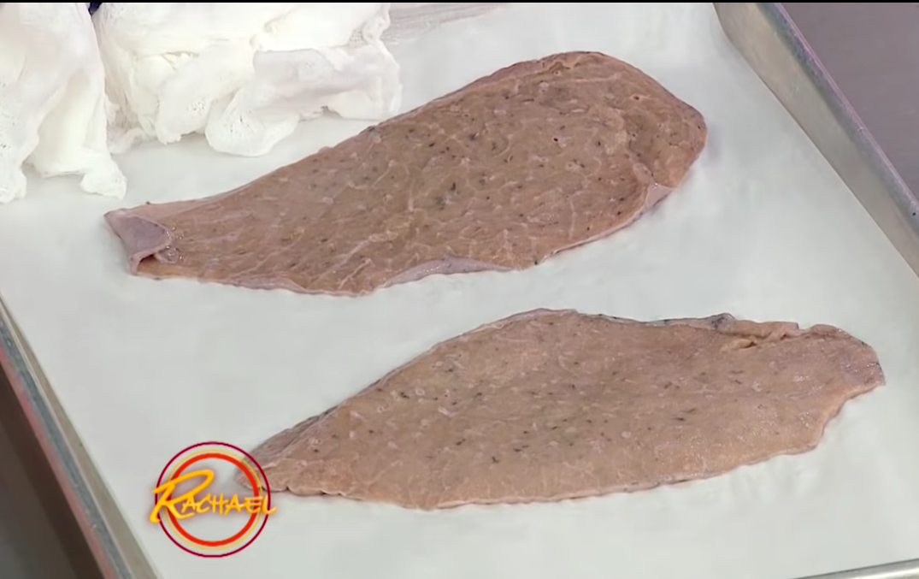
-“Numbers of E-cigs droplets deposited in pulmonary and tracheobronchial regions were approximately 2x (two-fold) higher than the numbers of deposited cigarette particles in these regions”.
[Manigrasso et al. (2015), Pichelstorfer et al. (2016)]”
Source: https://youtu.be/eI2rXveqhBI
Notes:
Talking Points:
-“Numbers of E-cigs droplets deposited in pulmonary and tracheobronchial regions were approximately 2x (two-fold) higher than the numbers
of deposited cigarette particles in these regions”. [Manigrasso et al. (2015), Pichelstorfer et al. (2016)]”
-“Nicotine is primarily absorbed from gaseous/vapor phase, not from deposited particles or droplets”. [Pichelstorfer et al. (2016)]
-“Deeper and slower inhalation with a breath-hold enhances droplet deposition in the pulmonary region..” [Sosnowski and Kramek-
Romanowska (2016)]
-Internal resistance to the airflow : smoking requires less respiratory effort than vaping.
Source: Image comparison. Two lungs, one impacted by regular smoke and the other lung in normal conditions.
Video source: https://youtu.be/eI2rXveqhBI
-Sosnowski, Tomasz R, and Marcin Odziomek. “Particle Size Dynamics: Toward a Better Understanding of Electronic Cigarette Aerosol Interactions With the Respiratory System.” Frontiers in physiology vol. 9 853. 9 Jul. 2018, doi:10.3389/fphys.2018.00853
https://www.ncbi.nlm.nih.gov/pmc/articles/PMC6046408/

Slide 10
Electronic Nicotine Delivery Systems (ENDS)
Electronic cigarettes, also known as e-cigarettes, e-cigs or Electronic Nicotine Delivery Systems (ENDS), are typically cigarette-shaped battery-powered electronic devices that produce an aerosol that users inhale.
Vaporizing -> Aerosol
Solid state/Liquid/Oil + Heat + Vaporization = Aerosol
Images: CC0 Creative Commons
https://www.thoughtco.com/history-of-aerosol-spray-cans-1991231
Image: https://www.flickr.com/photos/127173209@N05/16161316908/
Notes:
Talking Points:
“An aerosol is a suspension of tiny particles of liquid, solid, or both within a gas.”
“An aerosol is a colloid of fine solid particles or liquid droplets, in air or another gas. Aerosols can be natural or artificial.
Frederick G. Donnan presumably first used the term aerosol during World War I to describe an aero-solution, clouds of microscopic particles in air.”
Source:
Images: CC0 Creative Commons/Free for commercial use. No attribution required
https://www.thoughtco.com/history-of-aerosol-spray-cans-1991231
http://www.bat-science.com/groupms/sites/BAT_9GVJXS.nsf/vwPagesWebLive/DO9BWCDH

Slide 11
Time - sec 27 - 1.33 sec.
Adam Matthew Leventhal, PhD
Prof. of Preventive Medicine
Inst.for Health Promotion & Disease Prevention
Notes:
Talking Points:
Battery operated devices. Which heats a solution, then it vaporizes, turning it into an aerosol, which is a gas with suspended particles in it, and in turn it is inhaled.
Time - sec 27 - 1.33 sec.
Source: Recovery Answers
Adam Matthew Leventhal, PhD
Professor of Preventive Medicine
Institute for Health Promotion & Disease Prevention
SSB 302C 2001 N. Soto Street
Health Sciences Campus
Los Angeles
Published on May 19, 2017.
Learn more at:
https://www.recoveryanswers.org/
https://youtu.be/Ga2whgsexHM

Slide 12
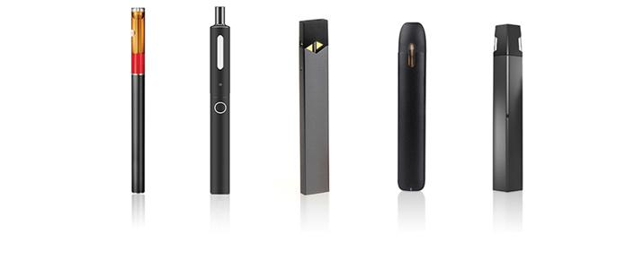
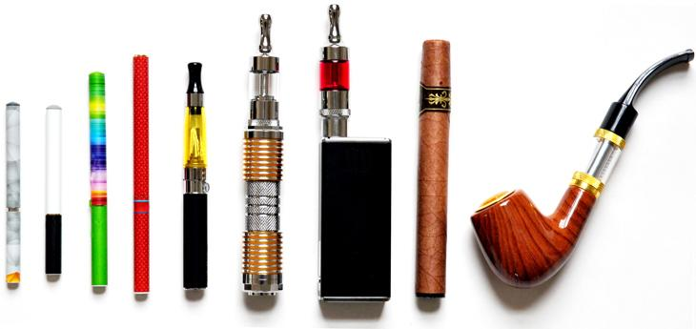
Types
1-Dry ingredients
(herbs, oil, wax)
2-Wet Ingredients
(liquids)
3-Direct Heat
4-Indirect Heat
(circulating heat air)
JUUL
E-CIGARETTE: No maintenance, needs recharge, smaller and disposable. Atomizer has a limited use life.
E-cigar
MOD
E-pipes
BOX-MOD: maintenance, refilling and changing parts: produce large amount of smoke
OIL-VAPES:Used for wax, oil, or concentrates. Has a chamber.
E-cigarettes
Image Source CC0 Creative Commons:
https://www.fda.gov
Notes:
Talking Points:
There Are Now 7,700 Flavors and 460 Brands of E-Cigarettes Jun 17 2014 (University of California, San Diego )
Most products are imported from China which is the largest manufacturer of e-cigarettes, producing 95% of the world’s e-cigarettes, primarily for the European and the U.S. consumer markets [16]”
1-Dry ingredients: (herbs, oil, wax)
2-Wet Ingredients: liquids
3-Direct Heat
4-Indirect Heat : circulating heat air
Source:
https://www.forbes.com/sites/yanzhonghuang/2014/05/27/e-cigarettes-chinas-next-growth-industry/#29671b86f0c5
Image Source CC0 Creative Commons:
https://www.researchgate.net/publication/263205674_Four_hundred_and_sixty_brands_of_e-cigarettes_and_counting_Implications_for_product_regulation
https://www.fda.gov/tobaccoproducts/labeling/productsingredientscomponents/ucm456610.htm
https://lotolabs.com/types-of-vapes
https://www.drugabuse.gov/publications/drugfacts/electronic-cigarettes-e-cigarettes
Zhu, Shu-Hong & Sun, Jessica & Bonnevie, Erika & Cummins, Sharon & Gamst, Anthony & Yin, Lu & Lee, Madeleine. (2014). Four hundred and sixty brands of e-cigarettes and counting: Implications for product regulation. Tobacco control. 23 Suppl 3. iii3-iii9. 10.1136/tobaccocontrol-2014-051670.

Slide 13
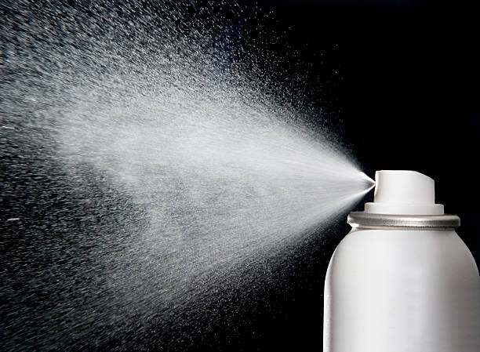
nnn
Gas
Vaporization
Aerosol
Suspension system of solid or liquid particles in a gas
Liquid <---> Gas
A substance in the gas phase
Condensation
WATER VAPORIZED
PARTICLES AEROSOLIZED
Micro-particles suspended
smoke is an aerosol, not all aerosols are smoke.
Notes:
Talking Points:
Matter in liquid form is transformed into gas when it is exposed to Heat
The resulting gas is hot and may or may not contain small particles in it
The gas containing micro-particles in it is called Aerosol
When the gas temperature cools it then condensates and the microparticles precipites
The micro-particles deposited, coat the walls in the alveoli
An Aerosol is a suspension system
Propylene Glycol boiling point 180°C and
Glycerol boiling point : 300°C
Propylene Glycol and glycerol droplets can grow by taking-up the water vapor from the humid air (hygroscopic).
Cigarette smoke: fine solid and semi-volatile particles suspended in air.
Vaping: a amist of liquid droplets suspended in the mixture of vapors and air.
Source:
https://www.ncbi.nlm.nih.gov/pmc/articles/PMC6046408/
Sosnowski, Tomasz R, and Marcin Odziomek. “Particle Size Dynamics: Toward a Better Understanding of Electronic Cigarette Aerosol Interactions With the Respiratory System.” Frontiers in physiology vol. 9 853. 9 Jul. 2018, doi:10.3389/fphys.2018.00853
https://www.ncbi.nlm.nih.gov/pmc/articles/PMC6046408/
Sosnowski, Tomasz R, and Marcin Odziomek. “Particle Size Dynamics: Toward a Better Understanding of Electronic Cigarette Aerosol Interactions With the Respiratory System.” Frontiers in physiology vol. 9 853. 9 Jul. 2018, doi:10.3389/fphys.2018.00853

Slide 14
Source: TobaccoFreeCA
Notes:
Image source: Source TobaccoFreeCA
https://youtu.be/fjDP8rTktWw
https://www.flavorshookkids.org/

Slide 15
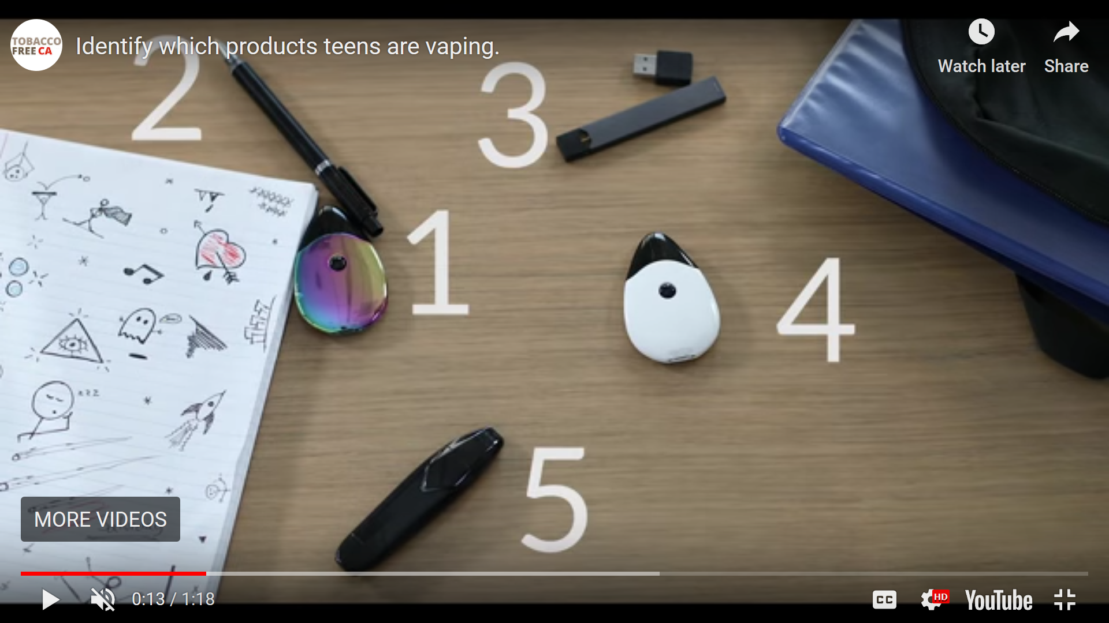
Source: TobaccoFreeCA
Notes:
Image source: Source TobaccoFreeCA
https://youtu.be/fjDP8rTktWw
https://www.flavorshookkids.org/

Slide 16
Hiding in Plain View
Oct 10, 2019
https://youtu.be/iLSo9L4uOkw
Notes:
Talking Points:
“Several products are now on the market that make it easy for kids to disguise and hide e-cigarettes as everyday objects such as pens, smartwatches and more. NBC’s Vicky Nguyen puts parents and teachers to the test to see if they can find the hidden vaping devices”. October 10, 2019.
Source: TODAY: https://youtu.be/iLSo9L4uOkw

Slide 17
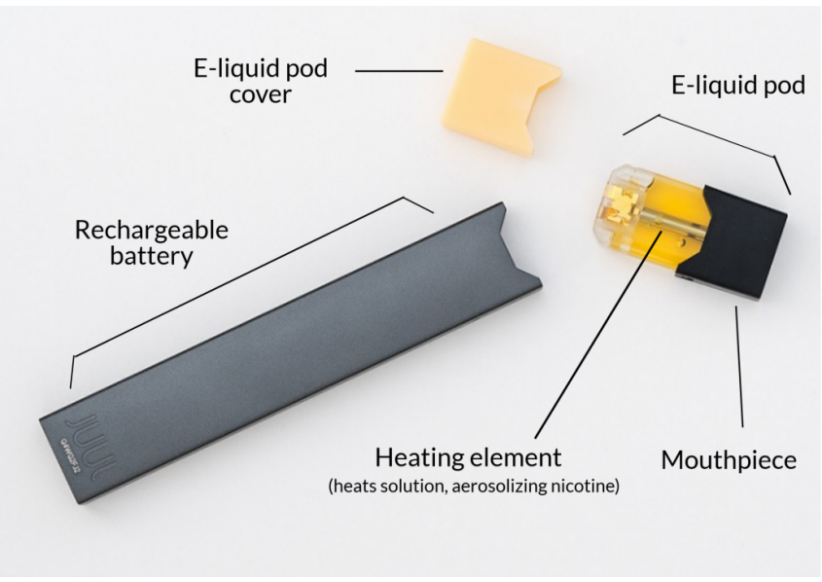
Image source: https://fr.m.wikipedia.org/wiki/Fichier:Parts_of_an_Electronic_cigarette.png
Image source: https://www.kingcounty.gov/depts/health/tobacco/data/e-cigarettes.aspx
Notes:
Talking Points:
“Most e-cigarettes consist of four different components, including:
-a cartridge or reservoir, which holds a liquid solution (e-liquid or e-juice) containing varying amounts of nicotine, flavorings, and other chemicals
-a heating element (atomizer)
-a power source (usually a battery)
-a mouthpiece that the person uses to inhale”
Source:
https://www.drugabuse.gov/publications/drugfacts/electronic-cigarettes-e-cigarettes
https://www.kingcounty.gov/depts/health/tobacco/data/e-cigarettes.aspx
https://www.drugabuse.gov/publications/drugfacts/electronic-cigarettes-e-cigarettes

Slide 18
Juuling
Time : Sec. 0-3:08 mins. Source: ABC News
https://www.youtube.com/watch?v=EmjVU_jZYV0 (Jun 27, 2018)
Notes:
“Juuling derives from Juul, a popular vaping device that heats up liquid nicotine that users inhale.”
Time : Sec. 0-3:08 mins
Source: https://www.youtube.com/watch?v=EmjVU_jZYV0

Slide 19
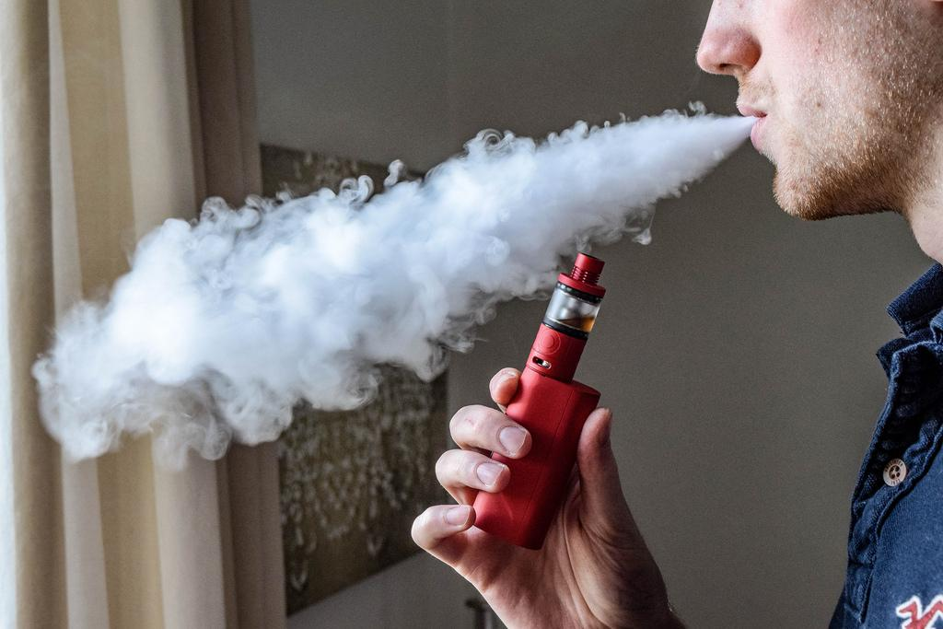
Vaping is the process...
Aerosol is the result
AEROSOL:
Has solid particles
GAS:
Does not have solid particles
Condensation + sedimentation
Solid state/Liquid/Oil + Heat + Vaporization = Aerosol
Images: CC0 Creative Commons/ Source: https://www.flickr.com/photos/vaping360/27691253506
Notes:
Talking Points:
-“Deeper and slower inhalation with a breath-hold enhances droplet deposition in the pulmonary region..” [Sosnowski and Kramek-
Romanowska (2016)]
-Internal resistance to the airflow : smoking requires less respiratory effort than vaping.
- In Vaping: droplets remaining for some period mouth then evaporate, decreases their size and the surrounding vapor may condense on droplets in the mouth.
-In the mouth surface: droplets may coagulate and increase the average droplet size.
-Vapor may be absorbed by the walls of the month y which reduces the vapor concentration in the gas phase, and reduce driving force for evaporation/condensation processes.
-Increase droplets deposition on the surface of the oral cavity. from 500 nm to grow to almost 900 nm.
Images: CC0 Creative Commons/Free for commercial use. No attribution required
Source: https://www.flickr.com/photos/vaping360/27691253506
Sosnowski TR, Odziomek M. Particle Size Dynamics: Toward a Better Understanding of Electronic Cigarette Aerosol Interactions With the Respiratory System. Front Physiol. 2018;9:853. Published 2018 Jul 9. doi:10.3389/fphys.2018.00853

Slide 20
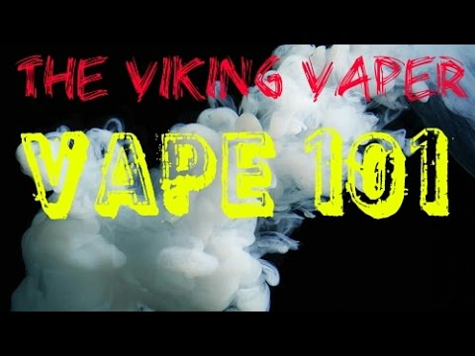
Dripping
“A study of high school students found that 1 in 4 teens reported using e-cigarettes for dripping..”
Teens reported the following reasons for dripping: to create thicker vapor (63.5 percent), to improve flavors (38.7 percent), and to produce a stronger throat hit—a pleasurable feeling that the vapor creates when it causes the throat to contract (27.7 percent)”
Video:
https://youtu.be/rCfFyypZiiU
Notes:
Talking Points:
“a study of high school students found that one in four teens reported using e-cigarettes for dripping, a practice in which people produce and inhale vapors by placing e-liquid drops directly onto heated atomizer coils. Teens reported the following reasons for dripping: to create thicker vapor (63.5 percent), to improve flavors (38.7 percent), and to produce a stronger throat hit—a pleasurable feeling that the vapor creates when it causes the throat to contract (27.7 percent).²”
Villanti AC, Johnson AL, Ambrose BK, et al. Flavored Tobacco Product Use in Youth and Adults: Findings From the First Wave of the PATH Study (2013-2014). Am J Prev Med. March 2017. doi:10.1016/j.amepre.2017.01.026
Source: https://www.drugabuse.gov/publications/drugfacts/electronic-cigarettes-e-cigarettes
Video:
https://youtu.be/rCfFyypZiiU

Slide 21
Teens say:
“This is not vaping, it is Juuling.”
“JUUL has multiple flavors.”
“It’s definitely more discreet.”
“JUULs are simple and easy to use.”
The JUUL device, with its sleek design that resembles a flash drive, is a special hit with teens.
Fredy L. Martinez, MS. Ed. CSAC. QMHP ACPS K-12 Substance Abuse Prevention & Intervention Services Coordinator
Notes:
Source: E-cigarettes and Other Emerging Tobacco Products. DMV Regional Tobacco Use Control and Prevention Meeting Navigating the Challenges, Barriers, and Solutions Together. Jim D. Martin, MS Director of Policy and Programs. NC. Tobacco Prevention and Control, Division of Public Health. May 15 2018.

Slide 22
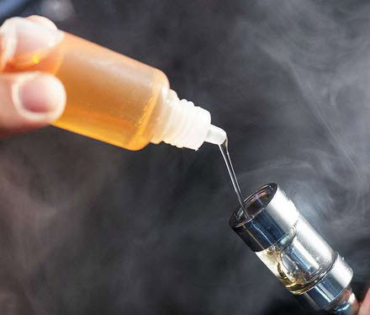
E-LIQUID
7,000 unique e-liquid flavors available to e-cigarette users (Zhu et al., 2014),
“Kucharska and colleagues (2016) have identified 113 chemicals in 50 brands of liquids”
Image source:www.ecigarettegroup.org
National Academies of Sciences, Engineering, and Medicine (2018)
Notes:
Talking Points:
“60 to 70 compounds detected in E-liquids”
“Kucharska and colleagues (2016) have identified 113 chemicals in 50 brands of liquids”
“Even more compounds are observed in the aerosol over their respective solution because some chemicals are generated during the vaporization process.”
“An aerosol generated from a single product tested by Herrington and Myers (2015) showed 18 additional compounds observed in the solution.”
Image source:
http://www.ecigarettegroup.org/wp-content/uploads/2016/07/adding-ecig-flavor.jpg
Source:
https://www.ncbi.nlm.nih.gov/books/NBK507184/
National Academies of Sciences, Engineering, and Medicine; Health and Medicine Division; Board on Population Health and Public Health Practice; Committee on the Review of the Health Effects of Electronic Nicotine Delivery Systems; Eaton DL, Kwan LY, Stratton K, editors. Public Health Consequences of E-Cigarettes. Washington (DC): National Academies Press (US); 2018 Jan 23. 5, Toxicology of E-Cigarette Constituents. Available from: https://www.ncbi.nlm.nih.gov/books/NBK507184/#

Slide 23
Would You Breath Food?
Source:
TobaccoFreeCA
Notes:
Talking Points:
Vaping devices are charged with liquids, this liquids are called ‘e-liquid’. This e-liquids contain many compounds that vaporizes when they are exposed to heat.
•This is e-liquid, or sometimes called e-juice.
•This is what is put into the e-cigarette/vape pen device and often contains flavors and nicotine.
•The e-juice is heated inside the device and creates the flavors and aerosol that is inhaled into the body and out into the air.
•There are over 15,500 flavors and counting, marketing to every kind of consumer.
Video source:
https://youtu.be/J3YLCCQa5fQ
https://youtu.be/SbwV_uopJZg
https://med.stanford.edu/tobaccopreventiontoolkit/E-Cigs/ECigUnit1.html

Slide 24
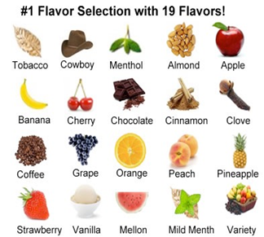
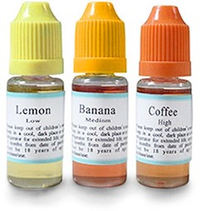
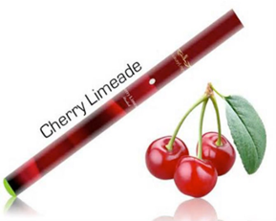
The flavorings used in e-juices can trigger an inflammatory response
Marketing e-Liquids
Diacetyl,cinnamaldehyde, acetoin, pentanedione, o-vanillin, maltol & coumarin
Frontiers in Physiology. Muthumalage T and others. Vol8. 2018.
Notes:
Talking Points:
Flavoring chemicals named:
-Diacetyl, cinnamaldehyde, acetoin, pentanedione, o-vanillin, maltol and coumarin at different doses between 10 and 1,000 μM (micrometer).”
Results:
“Treatment of the cells with flavoring chemicals and flavored e-liquid without nicotine caused presence of substances secreted by the immune system typical indication of inflammatory response.”
“Mixing of multiple flavors of e-liquids are more harmful to the users.”
Conclusions:
“potential pulmonary toxicity and tissue damage in e-cigarette users.”
Source:
Muthumalage T, Prinz M, Ansah KO, Gerloff J, Sundar IK and Rahman I (2018) Inflammatory and Oxidative Responses Induced by Exposure to Commonly Used e-Cigarette Flavoring Chemicals and Flavored e-Liquids without Nicotine. Front. Physiol. 8:1130. doi: 10.3389/fphys.2017.01130
https://www.frontiersin.org/article/10.3389/fphys.2017.01130.

Slide 25
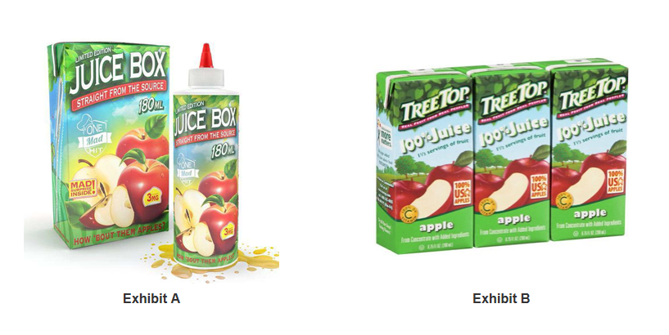
“...One Mad Hit Juice Box,” which resembles children’s apple juice boxes, such as Tree Top-brand juice boxes…”
Federal Trade Commission (FTC) and the U.S. Food and Drug Administration (FDA) May 1 , 2018
(FDA) May 1 , 2018
Notes:
Talking Points:
“Some examples of the products outlined in the warning letters, and being sold through multiple online retailers, include:
“One Mad Hit Juice Box,” which resembles children’s apple juice boxes, such as Tree Top-brand juice boxes; “Vape Heads Sour Smurf Sauce,” which resembles War Heads candy; and “V'Nilla Cookies & Milk,” which resembles Nilla Wafer and Golden Oreo cookies.
“Other products include “Whip’d Strawberry,” which resembles Reddi-wip dairy whipped topping, and “Twirly Pop,” which not only resembles a Unicorn Pop lollipop but is shipped with one.”
Source: https://www.ftc.gov/news-events/press-releases/2018/05/ftc-fda-take-action-against-companies-marketing-e-liquids

Slide 26
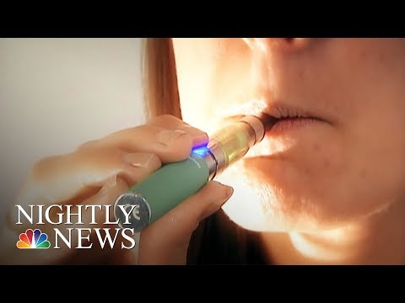
Source: NBC News Published on Mar 6, 2018
Notes:
Source: NBC News Published on Mar 6, 2018
https://www.youtube.com/watch?v=gqhCSiNpHbM
https://youtu.be/lqatWW7Ny28

Slide 27
PROPYLENE GLYCOL (Grana Et al, 2014)
HEAVY METALS +
ULTRA FINE PARTICLES
(CDC 2017, Rule 2018)
NICOTINE
THC
FLAVORS
VEGETABLE
GLYCERIN (VG)
E-cigarettes and Other Emerging Tobacco Products. DMV Regional Tobacco Use Control and Prevention Meeting Navigating the Challenges, Barriers, and Solutions Together. Jim D. Martin, MS Director of Policy and Programs. NC. Tobacco Prevention and Control, Division of Public Health. May 15 2018.
Hahn and colleagues (2014)
Notes:
Talking Points:
“E-cigarettes use humectants as solvent carriers in e-liquids to produce aerosols that simulate combustible tobacco cigarette smoke”
Example:
vaporizing solvents : to control and maintain the moisture
Propylene Glycol:
Synthetic liquid substance that absorbs water.
Used to make polyester compounds
Used as an antifreeze
Used as humectant ingredient (thinier)
Outcome: dry mouth and throat,
When decomposed by heat produces: carbonyl compounds (aldehydes)
Documented allergic reaction
“the kidneys eliminate 45 percent of the PG”
“the liver metabolizes the remainder to lactic acid, pyruvic acid, or acetone”.
Glycerol:
Commonly referred to as a “vegetable glycerin”.
Used as humectant ingredient
Used for creams (thicker)
Outcome: dry mouth and throat
When decomposed by heat produces: carbonyl compounds (aldehydes)
Naturally glycerol: in fats and oils
Synthetic glycerol : from petrochemical products. effects on reproductive function.
Too much effects: headache, dizziness, nausea, vomiting, thirst, and diarrhea.
Transformed into : glucose then into glycogen
Ethylene glycol:
Is an odorless, clear, slightly viscous liquid
Used as antifreeze in cooling and heating systems, in hydraulic brake fluids,
Used as an industrial solvent
A respiratory irritant and is associated with markedly enhanced toxicological hazards
Flavors:
Aldehydes formed when heated
Aldehydes may cause irritation to the respiratory tract
Hahn and colleagues (2014)
Source: https://www.ncbi.nlm.nih.gov/books/NBK507184/
E-cigarettes and Other Emerging Tobacco Products. DMV Regional Tobacco Use Control and Prevention Meeting Navigating the Challenges, Barriers, and Solutions Together. Jim D. Martin, MS Director of Policy and Programs. NC. Tobacco Prevention and Control, Division of Public Health. May 15 2018.
https://www.perioimplantadvisory.com/clinical-tips/article/16412201/vaping-and-oral-health-its-worse-than-you-think
Source:
https://www.ncbi.nlm.nih.gov/books/NBK507184/
National Academies of Sciences, Engineering, and Medicine; Health and Medicine Division; Board on Population Health and Public Health Practice; Committee on the Review of the Health Effects of Electronic Nicotine Delivery Systems; Eaton DL, Kwan LY, Stratton K, editors. Public Health Consequences of E-Cigarettes. Washington (DC): National Academies Press (US); 2018 Jan 23. 5, Toxicology of E-Cigarette Constituents. Available from: https://www.ncbi.nlm.nih.gov/books/NBK507184/

Slide 28
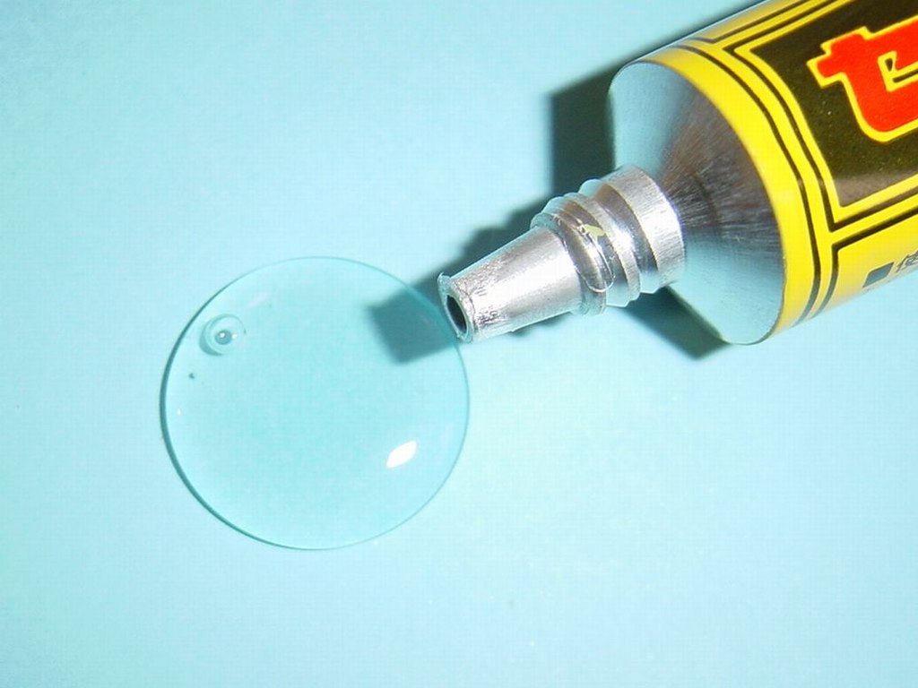
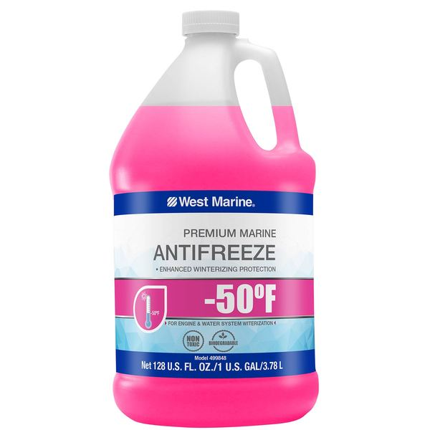
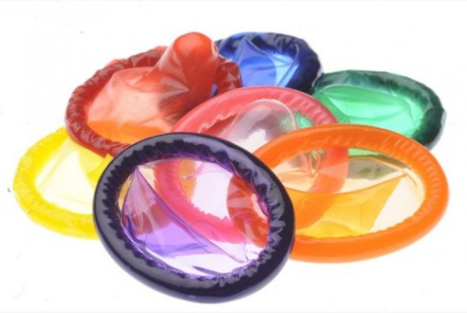
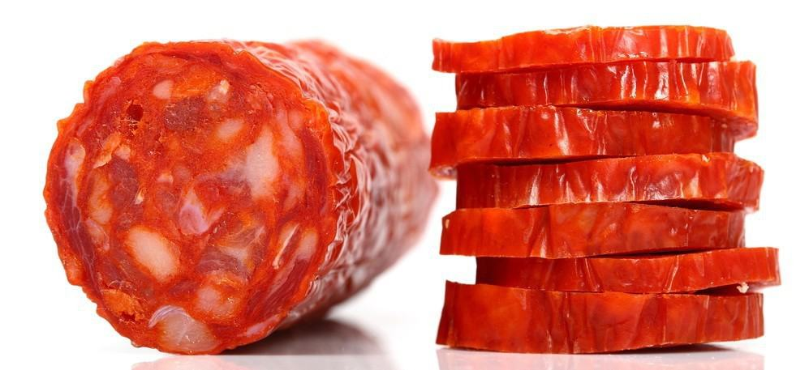
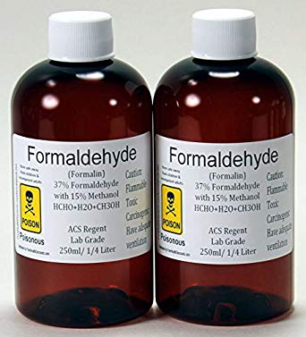
DIETHYLENE GLYCOL
PROPYLENE GLYCOL
NITROSAMINES(nitrate/nitrites)
METAL AND FIBER PARTICLES
FORMALDEHYDE
ACROLEIN
DIACETYL
ThE American Academy of Pediatrics. AAP. Pediatrics April 2018, VOLUME 141/ISSUE 4
National Academies of Sciences, Engineering, and Medicine (US); 2018 Jan 23.
Notes:
Talking Points:
“... inhalation of PG and glycerol can be safe up to 28 days (Werley et al., 2011) or 18 months (Robertson et al., 1947), breathing aerosolized PG can also affect the risk of asthma development (Choi et al., 2010).
“For example, one woman exhibited signs of exogenous lipoid pneumonia (e.g., fever, productive cough, and labored breathing) after using e-cigarettes for half a year (McCauley et al., 2012).”
“The e-cigarette's oil-based humectants likely caused her pneumonia, as her symptoms improved when she quit the device (McCauley et al., 2012).”
Carcinogenic substances identified in e-cig users:
e-cigarette : propylene oxide, acrylamide, acrylonitrile, and crotonaldehyde.¹³
-E-cigarettes (E-cigs) = Nicotine + (Organic Solvents [glycerol + propylene glycol]) + Electric-Heat (aerosolized) = Gas [nicotine + nitrosamine + (>7,000) incomplete combustion byproducts] {polycyclic aromatic hydrocarbons + aromatic amines + aldehydes + benzene}
Source:
Hecht SS, Carmella SG, Kotandeniya D, et al. Evaluation of toxicant and carcinogen metabolites in the urine of e-cigarette users versus cigarette smokers. Nicotine Tob Res. 2015;17(6):704–709pmid:25335945
Source:
https://pediatrics.aappublications.org/content/141/4/e20173557
https://www.lifeskillstraining.com/botvin-health-connections-addressing-the-e-cigarette-and-vaping-epidemic/
Rubinstein, Mark L., et al. “Adolescent Exposure to Toxic Volatile Organic Chemicals From E-Cigarettes.” Pediatrics, American Academy of Pediatrics, 1 Apr. 2018, pediatrics.aappublications.org/content/141/4/e20173557.
Source
https://www.ncbi.nlm.nih.gov/books/NBK507184/
National Academies of Sciences, Engineering, and Medicine; Health and Medicine Division; Board on Population Health and Public Health Practice; Committee on the Review of the Health Effects of Electronic Nicotine Delivery Systems; Eaton DL, Kwan LY, Stratton K, editors.
Washington (DC): National Academies Press (US); 2018 Jan 23.

Slide 29
E-liquids contains:
Micro solid, or oil particles:
Concentrated Nicotine: addiction
Artificial flavors: Irritation
Acetaldehyde: cancer
Diacetyl : inflammatory condition
Propylene Glycol: dry mouth & throat
Formaldehyde: cancer
Glycerol: irritation
Heavy metals: Poisoning.
Silver, iron, nickel aluminum, sodium, chromium, copper, magnesium, manganese, lead, potassium, silicate and more.
NIDA, November 2018
Notes:
Talking Points:
When an e-cigarette is turned on, the combination of heat applied to the liquid in the device’s chamber, triggers a vaporization of such liquid. The temperatures is enough to transform the some of the substances in the liquid cocktail into a gas state while other substances (like propylene) are not vaporized, but trapped in the released a gas in form of heated micro droplets (In other words, the gas in itself is hot and contains micro droplets suspended in it). This hot-white like-smoke (gas) with suspended micro droplets in it, is then inhaled and placed in the longs.
Source:
https://www.ncbi.nlm.nih.gov/pubmed/26774031
https://www.drugabuse.gov/research/research-data-measures-resources/nida-drug-supply-program/supplemental-information-nida-e-cig
https://www.atsdr.cdc.gov/toxprofiles/tp189-c2.pdf

Slide 30
Stanford Medicine. Tobacco Prevention Toolkid.Stanford University, 2018
Notes:
Talking Points:
Cigarette combustion produces approx. 7000 chemicals out of which 70 chemicals are known carcinogens (substances that produce cancer)
•Here is a list of chemicals found in regular cigarettes.
https://med.stanford.edu/tobaccopreventiontoolkit/E-Cigs/ECigUnit1.html

Slide 31
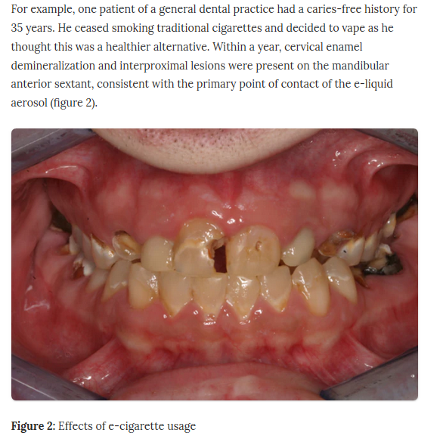
“those who used e-cigarettes (aka vaporizers) experienced significant tooth decay.”
Author Scott Froum, DDS Alisa Neymark, DDS.Online Journal. Pero-Implant Advisory. Jan 10th, 2019.
Jeffrey Kim, DDS, Ph.D. ADA lead researcher.
Notes:
Talking Points:
“New York periodontist Scott Froum, D.D.S. started noticing a troubling trend among his patients -- those who used e-cigarettes (aka vaporizers) experienced significant tooth decay.” Source: https://www.cnet.com/news/how-vaping-may-ruin-your-teeth/
Story 1:
One: “... The first involves a young man who had quit smoking traditional tobacco products by switching to e-cigarettes, which he had been using for five years. Believing vaping to be healthier, this patient smoked a cartridge a day, often chasing it with a sugar-laden energy drink to quench the resulting dry mouth. The combination left him with extensive tooth decay, enamel wear and, eventually, tooth loss.”
Story 2:
“the older gentleman who had also switched from traditional cigarettes to e-cigarettes. This patient had been cavity-free for 35 years, but within a year of taking up vaping, the enamel on his teeth started to erode and soften, increasing his risk of cavities.”
Dr: University of Rochester Medical Center study. Irfan Rahman, Ph.D.
““We showed that when the vapors from an e-cigarette are burned, it causes cells to release inflammatory proteins, which in turn aggravate stress within cells, resulting in damage that could lead to various oral diseases,”
““We learned that the flavorings–some more than others--made the damage to the cells even worse,”
https://www.urmc.rochester.edu/news/story/4667/first-ever-study-shows-e-cigarettes-cause-damage-to-gum-tissue.aspx
Source:
https://www.perioimplantadvisory.com/clinical-tips/article/16412201/vaping-and-oral-health-its-worse-than-you-think
Dr. Scott Froum writes monthly clinical tips. editorial director
Accessed September 2019. Last update 2019.
The American Dental Association. ADA.
https://www.ada.org/en/publications/ada-news/2018-archive/october/study-some-ecigarette-liquids-may-increase-caries-risk
Lead researcher: Jeffrey Kim, DDS, Ph.D.
Researcher: Jeffrey Kim, DDS, Ph.D.
https://www.ncbi.nlm.nih.gov/pmc/articles/PMC5314484/#CR19
https://www.urmc.rochester.edu/news/story/4667/first-ever-study-shows-e-cigarettes-cause-damage-to-gum-tissue.aspx

Slide 32
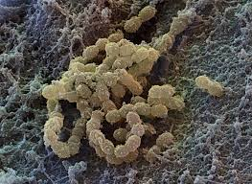
Propylene glycol (PG):
-Absorbs water = dry mouth : cavities, gum disease.
Streptococcus thrive breaking down toxins :
-Acetic acid + Lactic acid + Propionaldehyde toxic to enamel and gums
Vegetable glycerin (VG):
-Sucrose + flavoring = more Streptococcus mutans bacteria, more colonies of bacteria, enamel eroded.
Image source: https://www.sciencesource.com
Flavors:
-27% flavorings decrease in enamel hardness .
-The liquid viscosity (Streptococcus mutans to adhere to pits and fissures).
Nicotine:
-Vasoconstriction (gums blood flow)
-Altered proteins production (inflammation, immunity)
-Affects white blood cells (infections)
Author Scott Froum, DDS Alisa Neymark, DDS.Online Journal. Pero-Implant Advisory. Jan 10th, 2019.
Notes:
Talking Points:
Propylene glycol (PG):
-When PG is used orally, the breakdown products of PG include acetic acid, lactic acid, & propionaldehyde, which are all toxic to enamel & soft tissue.
-PG absorbs water, which means water molecules in saliva and oral tissue will bond to the PG molecules, leading to dry oral tissue: "dry mouth" : increase in cavities, and gum disease.
Vegetable glycerin (VG):
-it serves as a humectant, solvent, and sweetener
-It is 60% as sweet as sucrose
-It is sweet which is combined with flavoring which causes increase adhesion to teeths of Streptococcus mutans bacteria (or more) which causes colonies of bacteria to compact and erode the enamel
Flavors:
27% decrease in enamel hardness was demonstrated when flavorings were added
The viscosity of the e-liquid also allowed Streptococcus mutans to adhere to pits and fissures.
Source:
Kim, S. A., Smith, S., Beauchamp, C., Song, Y., Chiang, M., Giuseppetti, A., … Kim, J. J. (2018). Cariogenic potential of sweet flavors in electronic-cigarette liquids. PloS one, 13(9), e0203717. doi:10.1371/journal.pone.0203717
https://www.ncbi.nlm.nih.gov/pmc/articles/PMC6128655/
https://www.perioimplantadvisory.com/clinical-tips/article/16412201/vaping-and-oral-health-its-worse-than-you-think
https://www.drscottfroum.com/
Healthy saliva helps in the remineralization of tooth enamel, lubrication and protection of oral tissues, and reducing the risk for periodontal disease and infection.
Source: https://www.adafoundation.org/en/ada-foundation-research/principal-investigators/jeffrey-kim
Department of Periodontology, College of Dentistry, Princess Nourah Bint Abdulrahman University, Riyadh, Saudi Arabia. Electronic address: dr.munirah.ss@gmail.com.
Image:
“Color-enhanced Scanning Electron Micrograph (SEM) of Streptococcus mutans. This is an anaerobic, Gram-positive coccus-shaped bacterium commonly found in the human oral cavity. It is a significant contributor to tooth decay. Magnification: 22,000X at 8 x 10" image size.

Slide 33
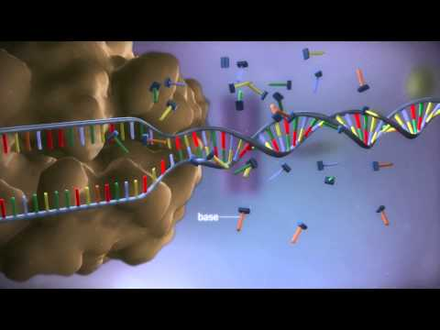
Oral cells of (e-cigs) users & cigarette smokers affected
Oral cells development are affected by Vaping
Vaping triggers abnormal expressions of miRNA in oral cells
“cancer” was the top disease associated with the deregulated genes in both e-cig users and smokers
Stella Tommasi, Andrew W. Caliri, Amanda Caceres, Debra E. Moreno, Meng Li, Yibu Chen, Kimberly D. Siegmund, ... Ahmad Besaratinia. (January 01, 2019). Deregulation of Biologically Significant Genes and Associated Molecular Pathways in the Oral Epithelium of Electronic Cigarette Users. International Journal of Molecular Sciences, 20, 3.)
International Journal of Molecular Sciences, vol. 20, no. 3, 2019. - Study February , 2019
Notes:
Talking Points:
Gene regulation allows cells to react quickly to changes in their environments. (turning genes on and off :adaptability: differentiation-dead-proliferation )
-Deregulation of Biologically Significant Genes and Associated Molecular Pathways in the Oral Epithelium of Electronic Cigarette Users.” International Journal of Molecular Sciences, vol. 20, no. 3, 2019.
Source:
News: https://beta.washingtonpost.com/health/2019/08/16/mystery-lung-illness-linked-vaping-health-officials-investigating-nearly-possible-cases
link: https://www.ncbi.nlm.nih.gov/pmc/articles/PMC6386888/
Video DNA : https://youtu.be/gG7uCskUOrA

Slide 34
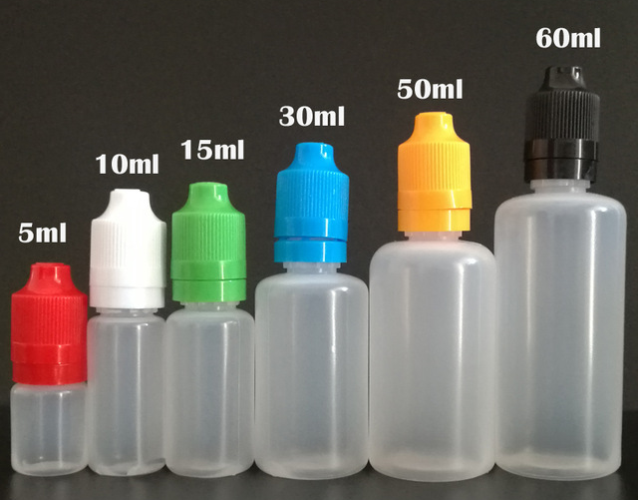
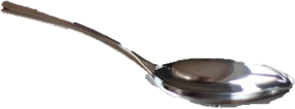
The typical 30 milliliter bottle has 6 teaspoons
milligrams (weight) per millilitre (volume)
Nicotine: 3%
5%
1 spoon: 5 millilitres (mL)
5 milligrams of Nicotine in 5 milliliter of a solution= 1mg/mL
“The lethal dose for a toddler, if ingested, is a bit over 1 milliliter of e-liquid with a 5 percent nicotine content” [1 mg/mL]
“A single teaspoon is toxic enough to kill five toddlers”
Dr. Robert Jackler.
Stanford Medicine.
Dr. Robert Jackler February 2019.
Notes:
Source:
https://med.stanford.edu/news/all-news/2019/02/5-questions-robert-jackler-says-juul-spurs-nicotine-arms-race.html

Slide 35
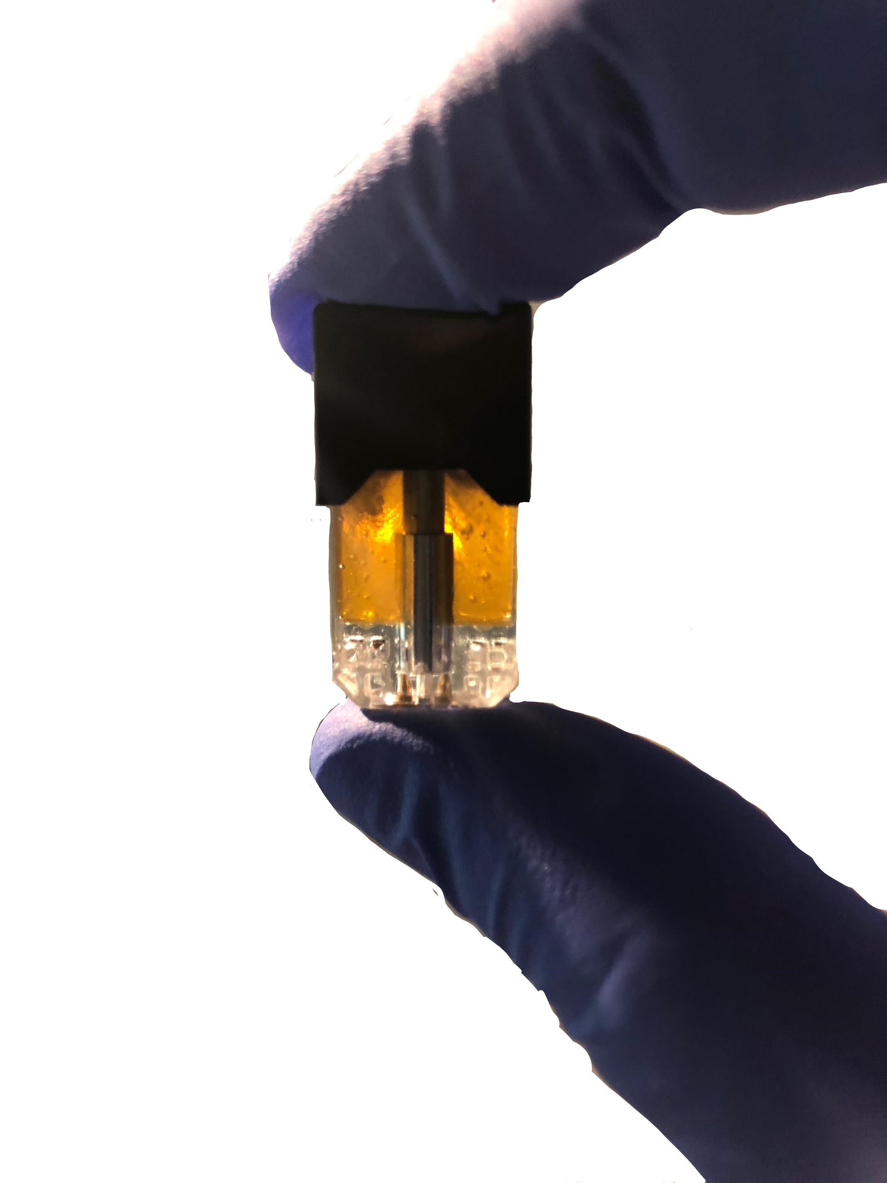
One JUUL pod is reported to contain 59 mg/mL, but one JUUL pod is only 0.7mL per pod. ​
[59 mg/mL] x [0.7mL] equals 41.3mg (NOTE: milliliter units cancel out)​
1 mg of Nicotine per cigarette
1 JUUL pod: Approx.40 cigarettes
1 pod per day
The lethal dose for adults is 60 mg or less.
5 % or 3% Concentrated
Stanford Medicine.
Dr. Robert Jackler. February 2019.
Notes:
Source:
https://truthinitiative.org/research-resources/emerging-tobacco-products/how-much-nicotine-juul
https://www.ncbi.nlm.nih.gov/pubmed/30896936
https://www.juul.com/calculator
https://med.stanford.edu/news/all-news/2019/02/5-questions-robert-jackler-says-juul-spurs-nicotine-arms-race.html
Image modified from original source:
Posted byu/Forzado- 1 year ago at https://www.reddit.com/r/juul/comments/8jf65v/cbd_juul_pod_ceramic_coil/
Source:
https://support.juul.com/home/learn/faqs/juulpod-basics
https://med.stanford.edu/tobaccopreventiontoolkit/E-Cigs/ECigUnit1.html (unit 2)

Slide 36
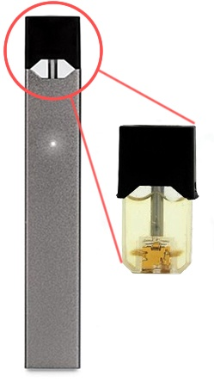
Source: https://truthinitiative.org
Image: Abby Fritz| Digital Design Editor on http://dailyorange.com
Notes:
Image credits :
Image modified for this presentation from original:
http://dailyorange.com/2018/10/experts-studies-weigh-in-on-effects-juuling/
https://www.reddit.com/r/juul/comments/8jf65v/cbd_juul_pod_ceramic_coil/
https://www.quora.com/What-are-JUUL-pods-made-of

Slide 37
https://youtu.be/TzxfC7CqbOQ
ABC news. August 2019.
Notes:
Source:
https://youtu.be/TzxfC7CqbOQ
ABC news. August 2019.
Other video: https://youtu.be/FSZu18vI8dI

Slide 38
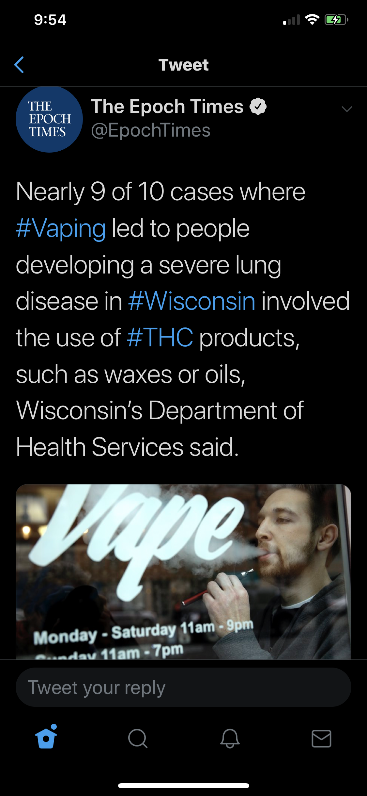
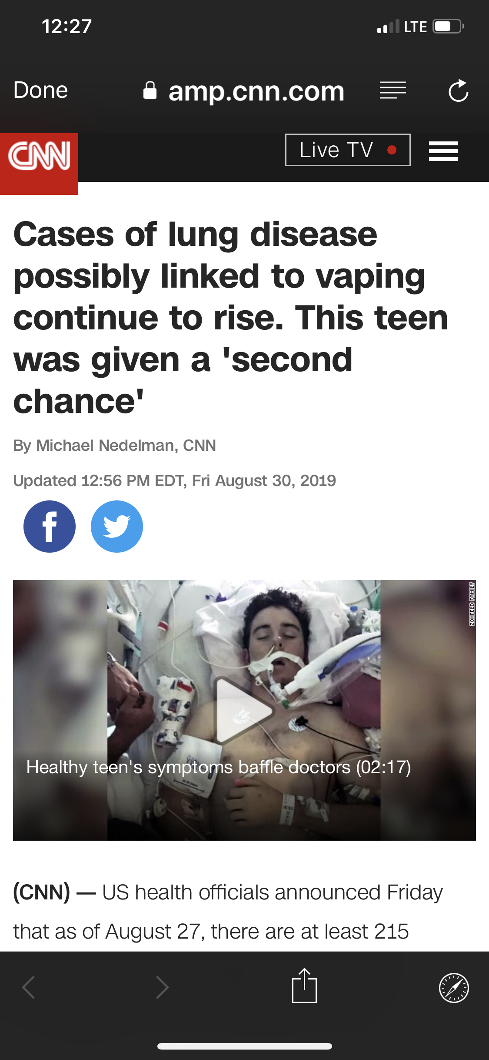
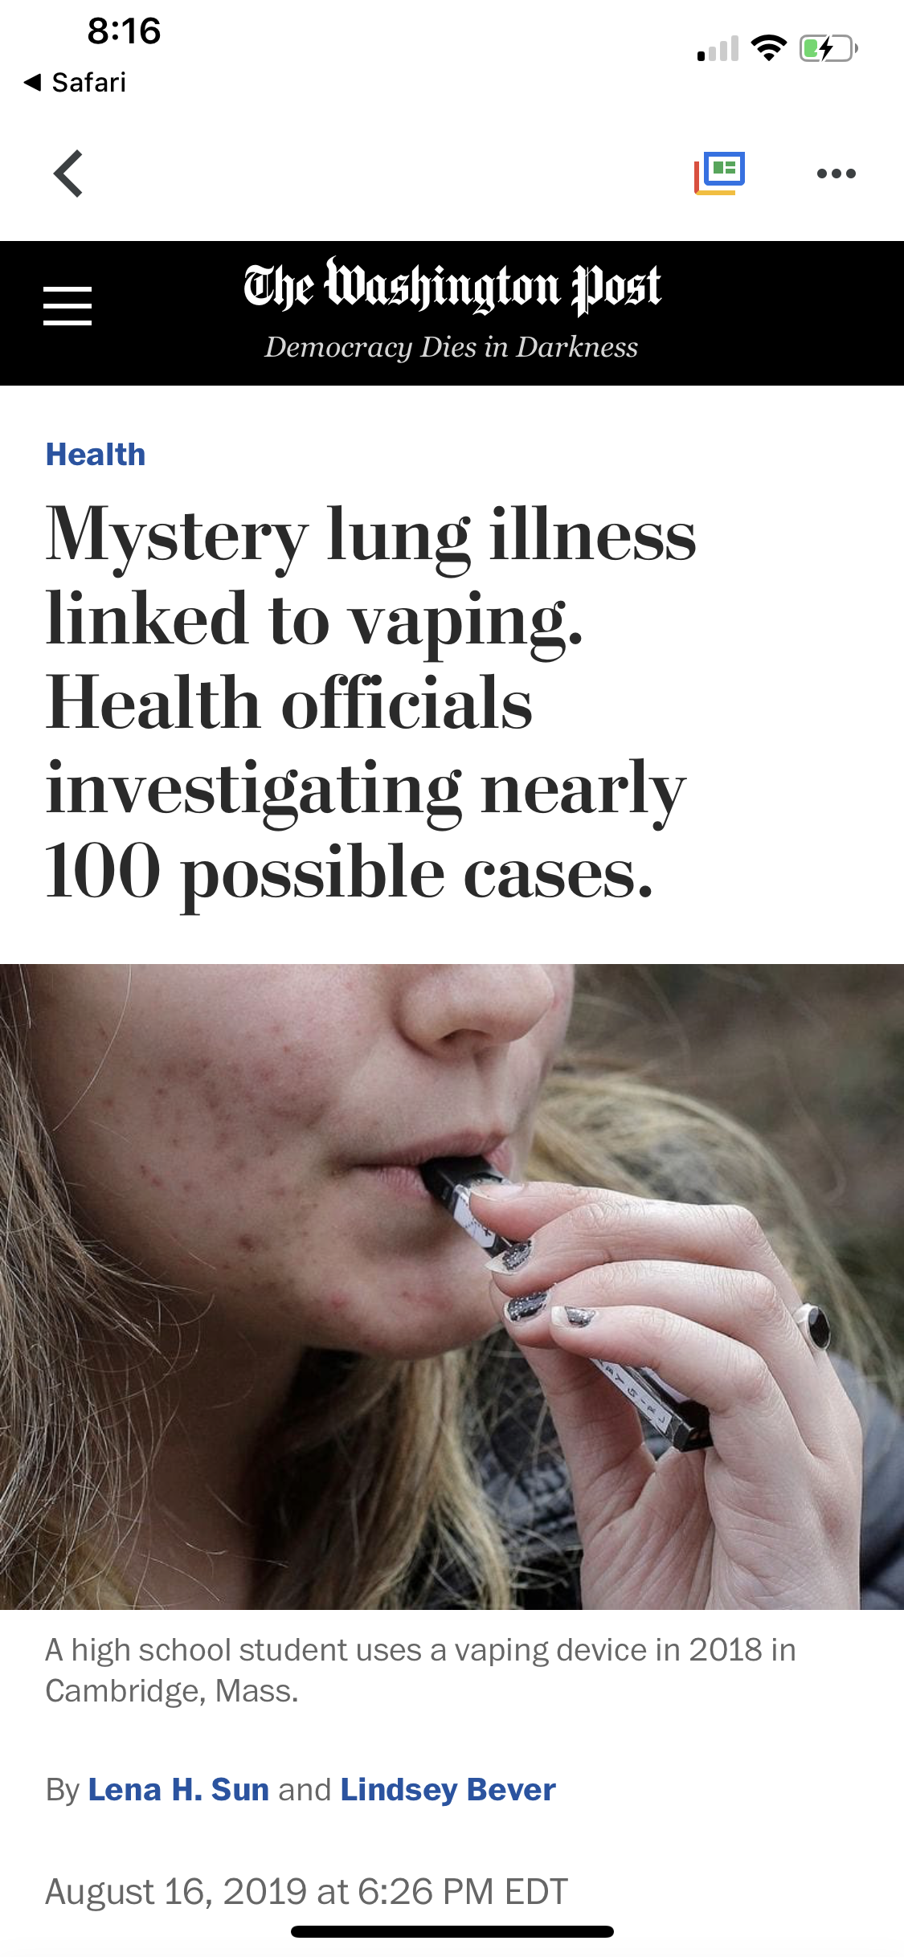
Notes:
Source:
https://www.buzzfeednews.com/article/danvergano/vaping-illness-outbreak-spread
https://www.washingtonpost.com/health/2019/08/16/mystery-lung-illness-linked-vaping-health-officials-investigating-nearly-possible-cases/
https://www.cnn.com/2019/08/30/health/vaping-lung-disease-texas-teen/index.html

Slide 39
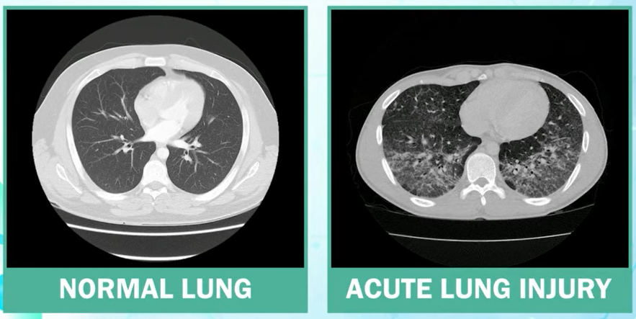
Hawaii Case
Acute lung injury associated with vaping
Dr. Alvin Bronstein, EMS and Injury Prevention System Branch Chief.Published Aug 19, 2019. CBS This Morning. https://youtu.be/hI473QvlK24
Notes:
Dr. Alvin Bronstein, EMS and Injury Prevention System Branch Chief.
~80% of patients report a history of vaping with THC.
~94% of patients reported the use of vaping within a week of symptom onset.
Source:
https://www.youtube.com/watch?v=hI473QvlK24&pbjreload=10
https://emcrit.org/ibcc/vaping-associated-pulmonary-injury/

Slide 40
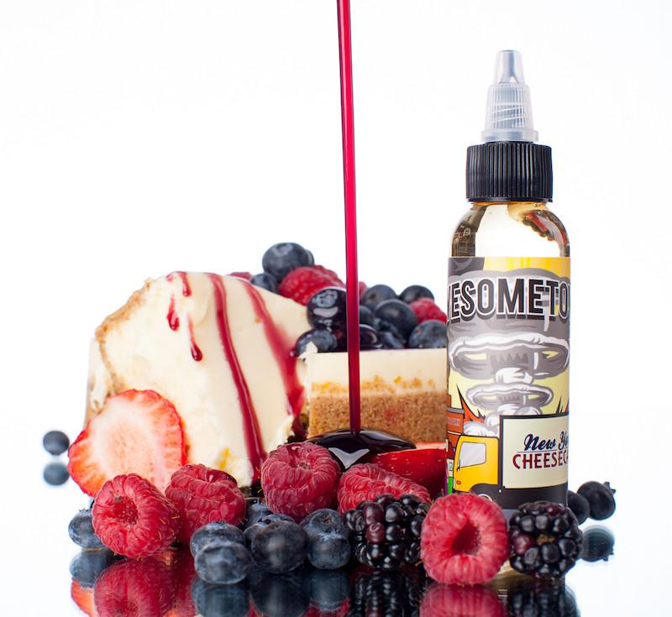
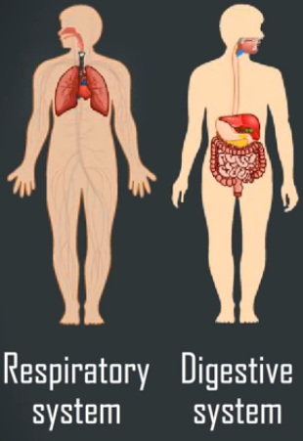
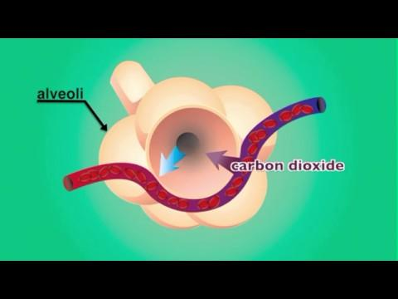
Would You Breath Food?
Mazzarella Educational Media, 2014. Gaseous Exchange in the Alveoli. [Video Segment]. Available from http://www.discoveryeducation.com
Mazzarella Educational Media, 2014
Notes:
Gaseous exchange : remove carbon dioxide from the blood and move oxygen into the blood
Alveoli : place of the gas exchange
Oxygen is INFUSED not the blood-stream
Carbon Dioxide is DEFUSE into the alveoli
Pressure difference between the Alveoli and the Blood stream causes the gas exchange
Mazzarella Educational Media, 2014. Gaseous Exchange in the Alveoli. [Video Segment]. Available from http://www.discoveryeducation.com

Slide 41
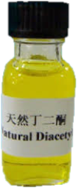
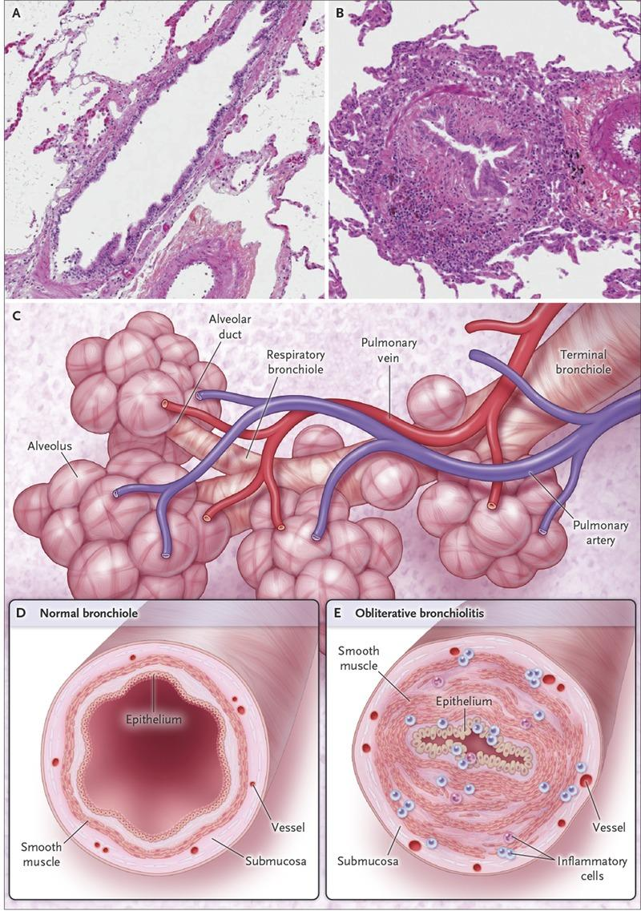
Diacetyl detected in vape smoke associated flavorings
How Harmful is Diacetyl?
Bronchiolitis obliterans (aka popcorn lungs) is an inflammatory condition caused by Diacetyl. (NIH 2016)
What it is?
Diacetyl was measured to be above the laboratory limit of detection in 39 of 51 of the flavors tested. (Harvard 2015)
Environmental Health Perspectives Journal, December 8, 2015,
Notes:
Talking Points:
“Diacetyl (also called 2,3-butanedione) is a chemical that has been used to give butter-like and other flavors to food products, including popcorn. (NIOSH)
Obliterative Bronchiolitis: obstructive ventilatory defect”
Diacetyl:
-When inhaled causes inflammation, scarring, and constriction of bronchioles (tiny airways) therefore lost of lung capacity
-Exposure to Diacetyl causes burning eyes, skin inflammation, dry cough, sore throat
-Irreversible damage
Source:
https://goo.gl/images/hVA6Hi
https://www.osha.gov/SLTC/flavoringlung/diacetyl.html
https://www.ncbi.nlm.nih.gov/pubmed/26335918
https://rarediseases.info.nih.gov/diseases/9551/bronchiolitis-obliterans
https://www.hsph.harvard.edu/news/press-releases/e-cigarette-flavoring-chemicals-linked-to-respiratory-disease/
https://www.lung.org/about-us/blog/2016/07/popcorn-lung-risk-ecigs.html
-“Flavoring Chemicals in E-Cigarettes: Diacetyl, 2,3-Pentanedione, and Acetoin in a Sample of 51 1 Products, Including Fruit-, Candy-, and Cocktail-Flavored E-Cigarettes,” Joseph G. Allen, Skye S. Flanigan, Mallory LeBlanc, Jose Vallarino, Piers MacNaughton, James H. Stewart, David C. Christiani, Environmental Health Perspectives, December 8, 2015, doi: 10.1289/ehp.1510185
-Salamanca JC, Meehan-Atrash J, Vreeke S, Escobedo JO, Peyton DH, Strongin RM. E-cigarettes can emit formaldehyde at high levels under conditions that have been reported to be non-averse to users. Sci Rep. 2018;8(1):7559.
-Sleiman M, et al. Emissions from electronic. cigarettes: key parameters affecting the release of harmful chemicals. Environ Sci Technol. 2016;50(17):9644–9651.
Image source:
https://www.alibaba.com/product-detail/Diacetyl-natural-431-03-8_1647949324.html

Slide 42
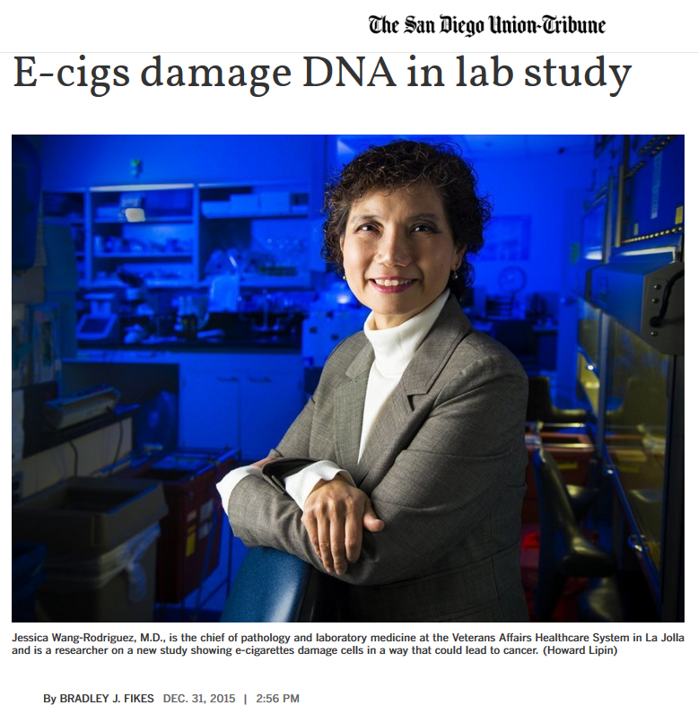
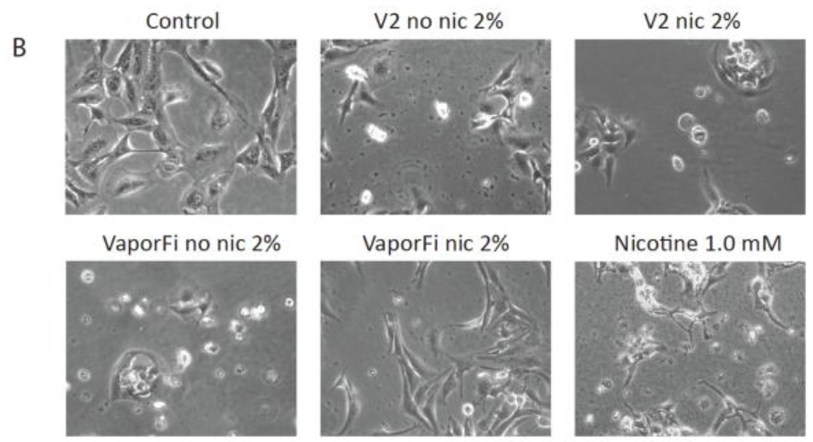
Heavy exposure to electronic cigarette vapor damages DNA in cell cultures, causing genetic instability that could lead to cancer,..”
Epithelial cells from organs (also lung)
“Moreover, even nicotine-free vapor induces this damage, indicating that other substances in e-cigarettes can damage cells, the study stated.”
Wang-Rodriguez December 2015 VA San Diego Healthcare System and UC San Diego researchers.
Notes:
Source:
https://www.research.va.gov/currents/1215-8.cfm
https://www.ncbi.nlm.nih.gov/pubmed/26547127
https://www.sciencedirect.com/science/article/abs/pii/S1368837515003620?via%3Dihub
https://www.research.va.gov/currents/1215-8.cfm

Slide 43
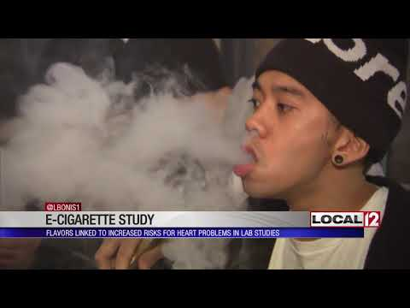
Source: https://youtu.be/Rg5Wjal9xXw
Jun 4, 2019
Notes:
Studies say e-cigarette flavors linked to increased risk for heart problems
News clip from LOCAL 12. CINCINNATI (WKRC) - A new study says there may be a hidden danger to e-cigarettes -- with or without nicotine.

Slide 44
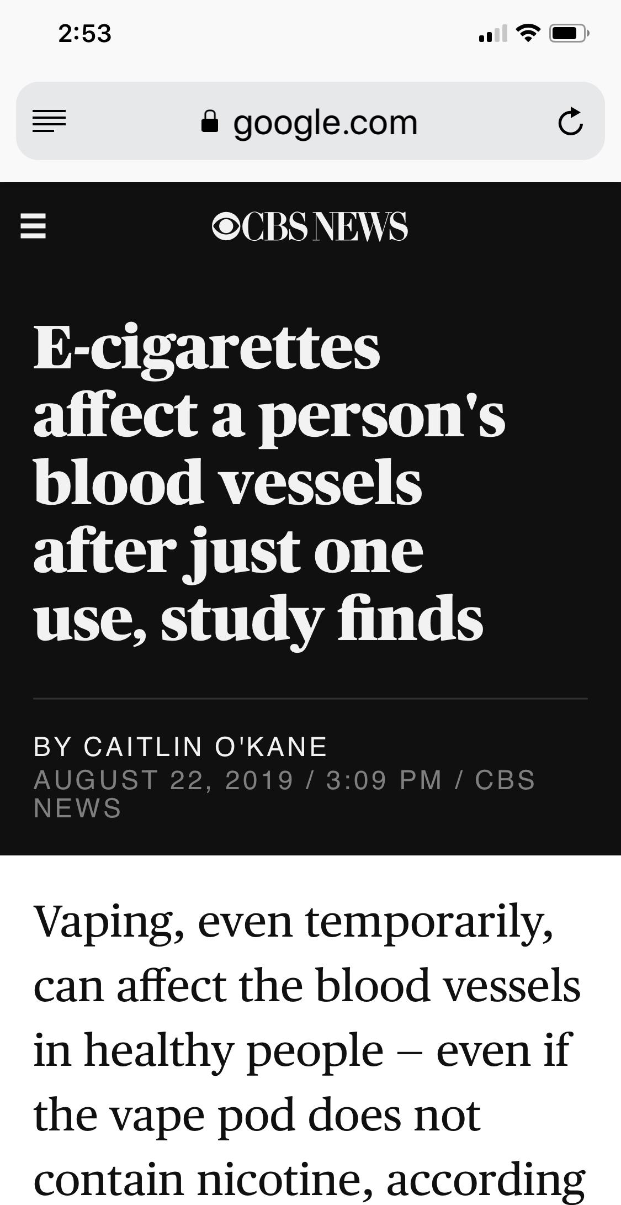
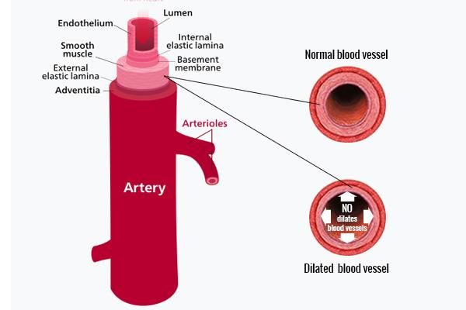
Short Term Effects of Vaping
Inhaling nicotine-free electronic cigarette aerosol for short time impacted endothelial function in healthy nonsmokers
20% reduction in venous oxygen saturation
Post-vaping: blood vessels did not dilate, widen, as much as before
"Acute Effects of Electronic Cigarette Aerosol Inhalation on Vascular Function Detected at Quantitative MRI." Collaborating with Drs. Caporale, Wehrli and Langham were Wensheng Guo, Ph.D., Alyssa Johncola, B.A., and Shampa Chatterjee, Ph.D. August, 2019.
Caporale, August 2019
University of Pennsylvania
Notes:
Talking Points:
-MRI exams
-31 healthy non-smoking adults
-Measure before and after nicotine-free e-cigarette inhalation.
-16 puffs, X 3 seconds each
-The e-cig. liquid:-Propylene glycol, Glycerol with flavoring, No nicotine.
-Exposure to aerosolized nicotine-free and nicotine-containing e-cigarette fluid on mouse lungs and normal human airway epithelial cells.
-1-hour daily for 4 months
-Normal human bronchial epithelial (NHBE) cells cultured at an air-liquid interface were exposed to e-cigarette vapours or nicotine solutions
-Inhalation of nicotine-containing e-cigarettes increased airway hyper-reactivity, distal airspace enlargement, mucin production, cytokine (peptide that influences cell replication, cell grow and inflammation processes) and protease expression (break down of proteins into small proteins and amoniacids).
-Showed impaired ciliary beat frequency, airway surface liquid volume
Conclusion:
-Exposure to inhaled nicotine-containing e-cigarette fluids triggered effects normally associated with the development of Chronic Obstructive Pulmonary Disease including cytokine expression, airway hyper-reactivity and lung tissue destruction. These effects were nicotine-dependent both in the mouse lung and in human airway cells, suggesting that inhaled nicotine contributes to airway and lung disease in addition to its addictive properties. Thus, these findings highlight the potential dangers of nicotine inhalation during e-cigarette use.
Source:
Garcia-Arcos I, Geraghty P, Baumlin N, et al Chronic electronic cigarette exposure in mice induces features of COPD in a nicotine-dependent manner Thorax 2016;71:1119-1129.
Source:
Alessandra Caporale, a postdoctoral researcher in the Laboratory for Structural, Physiologic, and Functional Imaging at the University of Pennsylvania in Philadelphia. Study August 2019
https://press.rsna.org/timssnet/media/pressreleases/14_pr_target.cfm?ID=2104
https://pubs.rsna.org/doi/10.1148/radiol.2019190562
https://www.medicalnewstoday.com/articles/326123.php
https://www.cbsnews.com/news/vaping-and-blood-vessels-e-cigarettes-change-a-persons-blood-vessels-after-just-one-use-long-term-effects-unknown/
https://www.livescience.com/e-cigarettes-constrict-blood-vessels.html
https://thorax.bmj.com/content/71/12/1119

Slide 45
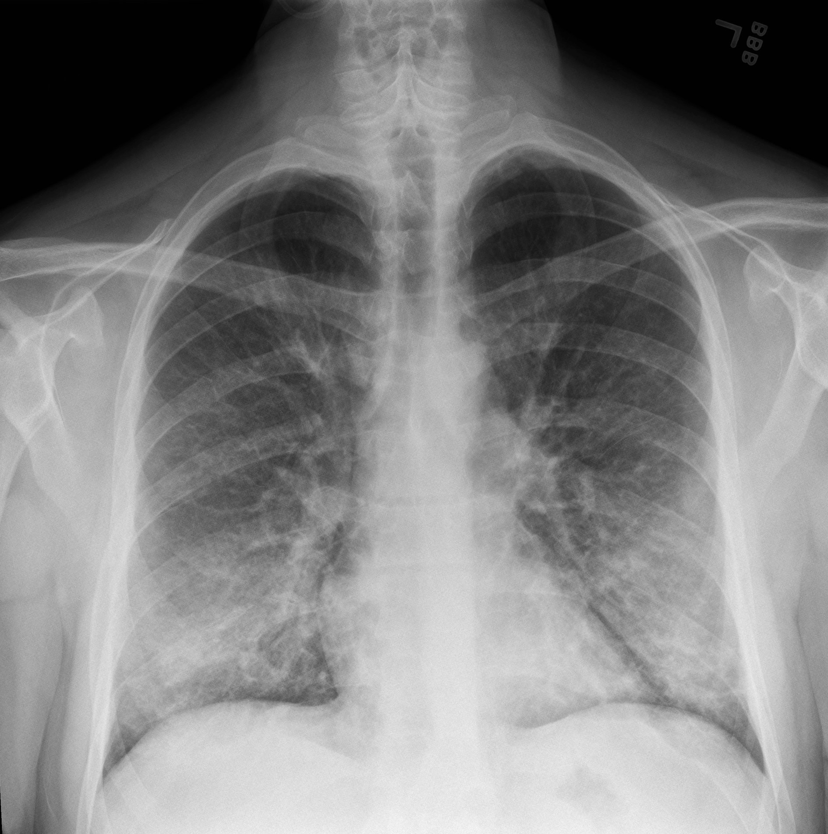
An X-ray of a patient with a vaping habit, showing lung damage — densities or whitish cloud-like areas typically associated with some pneumonias, fluid in the lungs or inflammation.
Credit: Intermountain Healthcare
bilateral pulmonary opacities
18-year-old:
(Long Island) Emergency Room.
-Gasping for breath
-Coughing
-Chest pain
-Vomiting (days)
-Dizzy.
-Shortness of breath,
- Diarrhea
-fever
-Fatigue
-Weight loss
https://www.nytimes.com/2019/08/31/health/vaping-marijuana-ecigarettes-sickness.html#click=https://t.co/Qlc122Conk
Dr. Melodi Pirzada, chief pediatric pulmonologist at NYU Winthrop Hospital in Mineola, N.Y.
Notes:
Dr. Melodi Pirzada, chief pediatric pulmonologist at NYU Winthrop Hospital in Mineola, N.Y.
Source: Published Aug. 31, 2019 Updated Sept. 11, 2019
An 18-year-old: Long Island emergency room.
-Gasping for breath
-Vomiting
-Dizzy.
-shortness of breath,
-several days with vomiting
-fever
-fatigue
Source:
https://www.cdc.gov/tobacco/basic_information/e-cigarettes/severe-lung-disease.html
https://www.nytimes.com/2019/08/31/health/vaping-marijuana-ecigarettes-sickness.html#click=https://t.co/Qlc122Conk
https://emcrit.org/ibcc/vaping-associated-pulmonary-injury/

Slide 46
Fiberoptic bronchoscopy
Healthy
Constricted & Mucus
Sunburn like surface
American Journal of Respiratory and Critical Care Medicine Volume 198 Number 1 | July 1 2018
Notes:
Source: E-cigarettes and Other Emerging Tobacco Products. DMV Regional Tobacco Use Control and Prevention Meeting Navigating the Challenges, Barriers, and Solutions Together. Jim D. Martin, MS Director of Policy and Programs. NC. Tobacco Prevention and Control, Division of Public Health. May 15 2018.
Ghosh, Arunava, et al. “Chronic E-Cigarette Exposure Alters the Human Bronchial Epithelial Proteome.” American Journal of Respiratory and Critical Care Medicine, American Thoracic Society, 1 July 2018, www.ncbi.nlm.nih.gov/pubmed/29481290.

Slide 47
Source: ttps://youtu.be/xNrD8uPPf4w
Code Scientia
Published on Sep 21, 2017
Notes:
Source: https://youtu.be/xNrD8uPPf4w
Code Scientia
Published on Sep 21, 2017
These immune cells are eating and destroying bacteria. They are called macrophages. Its job is to eliminate foreign entities that invade the human body. This process is called phagocytosis

Slide 48
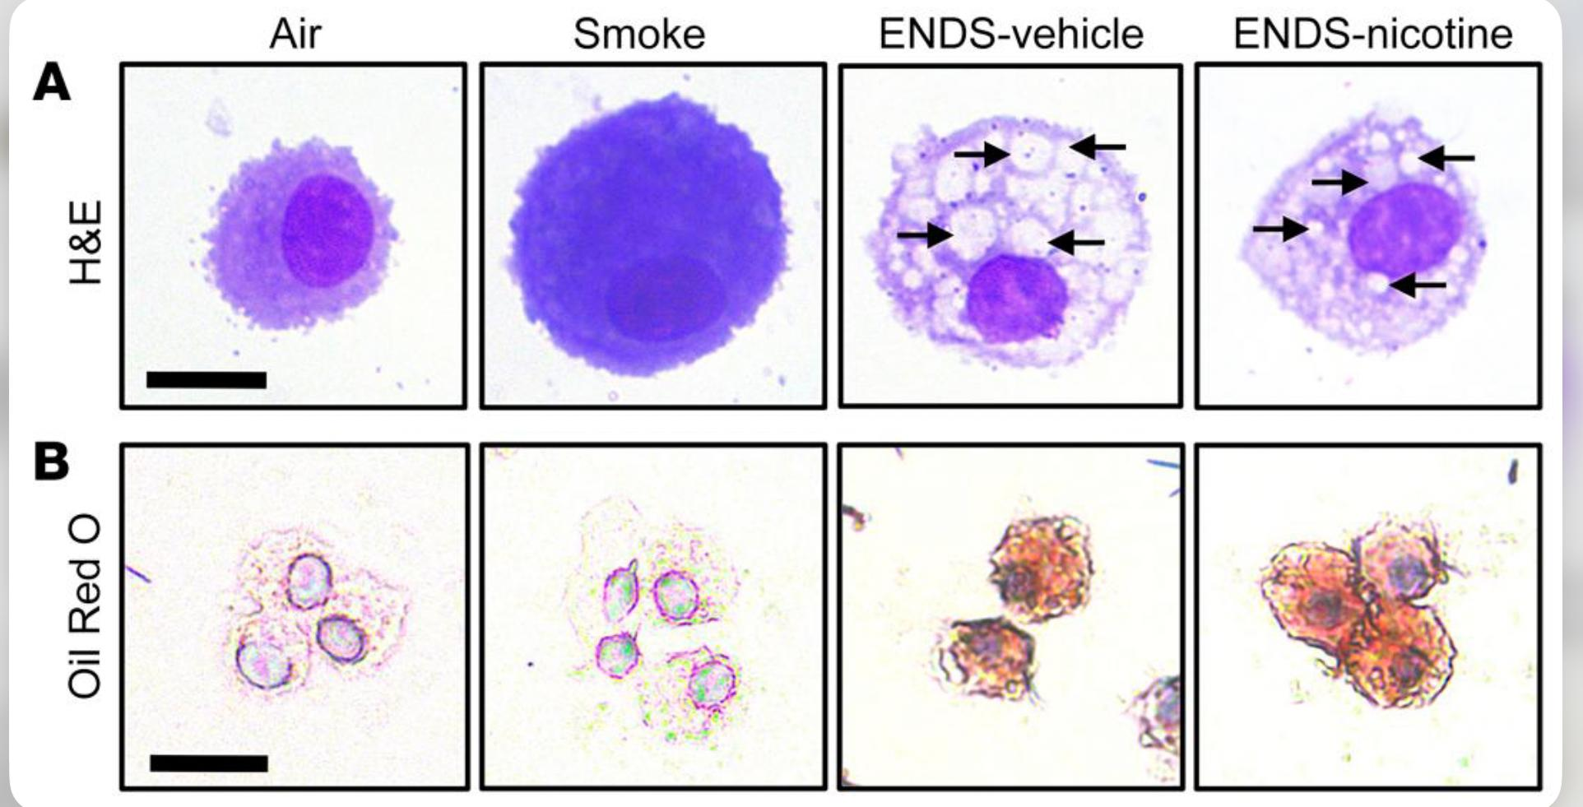
Does vaping forms inclusions of lipids in the cell cytoplasm?: Yes
Alveolar macrophages cells
ENDS no nicotine
Showed increased lipid accumulation independent of nicotine
-Mice were exposed to Air, Smoke, vape no-nicotine smoke , or vape nicotine for 4 months.
American Society for Clinical Investigation First published September 4, 2019
Notes:
Talking Points:
-Pulmonary inflammation or emphysema developed in mice (4 months)
-VAPING exposure, independent of nicotine, altered lung lipid homeostasis (fat presence) in alveolar macrophages and epithelial cells.
-Lipid deposition in alveolus
-Vapor exposure downregulated innate immunity against viral pathogens in resident macrophages.
-Macrophages are large, specialized cells that recognize, engulf and destroy target cells.
-Independent of nicotine, ENDS-exposed mice infected with influenza demonstrated enhanced lung inflammation and tissue damage.
[lysosome -- a structure in your cells that breaks down substances such as proteins, carbohydrates, and old cell parts so the body can recycle them]
Source: Link
https://www.inverse.com/amp/article/59009-vaping-lipoid-pneumonia-flu-risks?utm_campaign=organic&utm_medium=inverse&utm_source=twitter&__twitter_impression=true
https://www.jci.org/articles/view/128531
J Clin Invest. https://doi.org/10.1172/JCI128531. 2019 American Society for Clinical Investigation. First published September 4, 2019 - Version history. Received: March 6, 2019; Accepted: July 23, 2019
Clapp, P W, et al. “Cinnamaldehyde in Flavored e-Cigarette Liquids Temporarily Suppresses Bronchial Epithelial Cell Ciliary Motility by Dysregulation of Mitochondrial Function.” Am. J. Physiol. Lung Cell. Mol. Physiol. American Journal of Physiology - Lung Cellular and Molecular Physiology, vol. 316, no. 3, 2019, pp. L470–L486.

Slide 49
-Lavage fluid
-Foamy macrophage
--Neutrophils
Bronchial wall thickening,
Bronchial wall deformation
-Casting-off dead tissue
-Mucosal swelling
-More tissue surrounding the bronchiolus
17
cases
bacteria, viruses, fungi, poisons ,cancer cells
airway-centered chemical pneumonitis
Spread alveolar damage
‘sentinel cells’ increased s in the surrounding the bronchioles tissue and alveoli cells
Pathology of Vaping-Associated Lung Injury
NEJM.org.New England Journal of Medicine. Mayo Clinic October 2, 2019
Notes:
-Reviewed lung biopsies from 17 patients (13 men; median age, 35 years [range, 19–67]), all of whom had a history of vaping (71% with marijuana or cannabis oils) and were clinically suspected to have vaping-associated lung injury.
-Histopathological findings showed patterns of: acute lung injury, including acute fibrinous pneumonitis, diffuse alveolar damage, or organizing pneumonia, usually bronchiolocentric and accompanied by bronchiolitis (Figure 1; also see the Supplementary Appendix, available with the full text of this letter at NEJM.org).
-Neutrophils were often prominent [PRESENT WHEN: bacteria, viruses, fungi, poisons ,cancer cells]
-Neutrophils are a type of white blood cell. In fact, most of the white blood cells that lead the immune system’s response are neutrophils.
Source:
https://www.nejm.org/doi/full/10.1056/NEJMc1913069?query=featured_home
letter was published on October 2, 2019, at NEJM.org.
Brandon T. Larsen, M.D., Ph.D./ Mayo Clinic, Scottsdale, AZ. larsen.brandon@mayo.edu

Slide 50
vaping-associated lung injury
Chronic Obstructive Pulmonary Disease (COPD) is an umbrella term used to describe progressive lung diseases including emphysema, chronic bronchitis, and refractory (non-reversible) asthma. This disease is characterized by increasing breathlessness
Notes:
Image source: Source:
https://youtu.be/TzxfC7CqbOQ
ABC news. August 2019.

Slide 51
Source: https://youtu.be/9lGFlXrTwJU
3.6 million high schoolers used e-cigarettes in 2018—a staggering 78 percent increase from 2017
Notes:
Source: https://youtu.be/9lGFlXrTwJU
“Irritability" :30 TV - TobaccoFreeCA

Slide 52
Nicotine
Physical Withdrawals
Emotional Withdrawals
I can’t concentrate
I feel anxious, If I use I will feel better
My sleep is messed up, I feel tired and restless
I am feeling depressed
It’s like I cannot control my emotions, it suddenly changes
it's like everything irritates me
It just does not occur to me thinking about consequences
I feel the rush for adrenaline
Nicotine withdrawal. Source: https://www.drugabuse.gov
Notes:
Genes: CHRNA5, CHRNA3, CHRNAB4, CHNRB3
Nicotine Acetylcholine Receptors
Cholinergic neurons participate in the release of dopamine
Nicotine activate ion-channels in the neuron and keep them desensitized for several seconds
Increases glutamate activity in the brain
Reduces monoamine oxidase (MOA-A, MOA-B) enzimes activity
Source: Herron, Abigail J., and Timothy Brennan. The ASAM Essentials of Addiction Medicine. 2nd ed., Wolters Kluwer, 2015. pg 79-83
Website TitleWolters Kluwer. The ASAM Essentials of Addiction Medicine. Date Accessed November 18, 2018
https://www.asam.org/resources/publications/essentials-of-addiction-medicine
PHYSICAL
Sleep changes
insomnia
vivid dreams
fatigue
drowsiness
skin changes
Blemishes
Itchiness
Hives
Circulation
Diziness
Stiffness/Pain
Tingly fingers
Tingly toes
Bloating
Water weight gain
Mouth
Soreness
Bleeding gums
Respiratory issues
Congestion
Cough
Phlegm
Hoarseness
Breathlessness
Digestion
Heartburn
Gas
Flatulence
Nausea
Headache
Weight gain
Hormone changes
EMOTIONAL
Restlessness
Depression
Irritability
Crankiness
Difficulty concentrating
Anxiety
Mood Swings
Excitability

Slide 53
Nicotine in Adolescents
Nicotine interferes with the pre-frontal cortex maturation
Increases risk-taking
Increases impulsivity
Long term cognitive impairment
Reduced prefrontal cortex activity
Associated to later substance abuse and mental health problems
Associated to higher level of addiction in adulthood
Vulnerability to initiation
Incomplete development of the prefrontal cortex (decision making, impulse control, and executive function)
Source: Herron, Abigail J., and Timothy Brennan. The ASAM Essentials of Addiction Medicine. 2nd ed., Wolters Kluwer, 2015. pg 79-83 Website Title Wolters Kluwer. The ASAM Essentials of Addiction Medicine.Accessed November 18, 2018
Notes:
Talking Points:
Tobacco addiction is similar to heroin and cocaine addiction
Genes such as CYP2A6 contributes to the differing patterns of smoking behavior and smoking cessation.
Accelerates the development of chronic diseases across the full life course.
Source: Benowitz, N. (2016, November 17). Resources. Retrieved from E-Cigarette Summit 2016:
https://www.e-cigarette-summit.com/resources/
Source: Herron, Abigail J., and Timothy Brennan. The ASAM Essentials of Addiction Medicine. 2nd ed., Wolters Kluwer, 2015. pg 79-83
Website Title Wolters Kluwer. The ASAM Essentials of Addiction Medicine. Date Accessed November 18, 2018
https://www.asam.org/resources/publications/essentials-of-addiction-medicine
Benowitz, N. (2016, November 17). Resources. Retrieved from E-Cigarette Summit 2016: https://www.e-cigarette-summit.com/resources/

Slide 54
Nicotine is the Drug that Causes Addiction
Nicotine:
Mood modulator
Stress relief
Hunger relief
Causes arousal during fatigue
Relaxation during anxiety
Women metabolize nicotine faster than men
African Americans clear nicotine slower than Caucasians and Asians
Low doses: high blood pressure and heart rate
High doses: causes hypotension, and slow heart rate.
Source: Herron, Abigail J., and Timothy Brennan. The ASAM Essentials of Addiction Medicine. 2nd ed., Wolters Kluwer, 2015. pg 79-83 . Website Title Wolters Kluwer. The ASAM Essentials of Addiction Medicine. Accessed November 18, 2018
Fredy L. Martinez, MS. Ed. CSAC ACPS K-12 Substance Abuse Prevention & Intervention Services Coordinator
Notes:
Talking Points:
Proteine CYP2A6 metabolized nicotine into cotinine
Source: Herron, Abigail J., and Timothy Brennan. The ASAM Essentials of Addiction Medicine. 2nd ed., Wolters Kluwer, 2015. pg 79-83
Website TitleWolters Kluwer. The ASAM Essentials of Addiction Medicine. Date Accessed November 18, 2018
https://www.asam.org/resources/publications/essentials-of-addiction-medicine
F

Slide 55
NICOTINE ADDICTION
Diminish cognition
Reduce attention span
Enhance Impulsivity
Notes:
Talking Points: it is proven so far, that smoking nicotine causes addiction to the youth brain. Diminishes cognitions, enhance impulsivity, and refuse attention span.
source: Nida.gov

Slide 56
Fredy L. Martinez, MS. Ed. CSAC. QMHP ACPS K-12 Substance Abuse Prevention & Intervention Services Coordinator
Notes:
Source: Source: E-cigarettes and Other Emerging Tobacco Products. DMV Regional Tobacco Use Control and Prevention Meeting Navigating the Challenges, Barriers, and Solutions Together. Jim D. Martin, MS Director of Policy and Programs. NC. Tobacco Prevention and Control, Division of Public Health. May 15 2018.
NIDA. (2018, August 2). E-Cigarettes Promote Smoking Progression in Youth and Depress Quitting Among Adults. Retrieved from https://www.drugabuse.gov/news-events/nida-notes/2018/08/e-cigarettes-promote-smoking-progression-in-youth-depress-quitting-among-adults on 2018, November 18
Soneji, S., Barrington-Trimis, J. L., Wills, T. A., Leventhal, A. M., Unger, J. B., Gibson, L. A., Yang, J., Primack, B. A., Andrews, J. A., Miech, R. A., Spindle, T. R., Dick, D. M., Eissenberg, T., Hornik, R. C., Dang, R., Sargent, J. D. (in press). Association between initial use of e-cigarettes and subsequent cigarette smoking among adolescents and young adults: A systematic review and meta-analysis. JAMA Pediatrics.

Slide 57
“A reconstructed computed tomography showing a teen’s injuries after an e-cigarette exploded in his mouth”. NEJM
Injury from E-Cigarette Explosion
Micah G. Katz, M.D.,
and Katie W. Russell, M.D.
The New England Journal Of Medicine
https://www.nejm.org/doi/full/10.1056/NEJMicm1813769
Notes:
Talking Points:
-case study described a 17-year-old Nevada teenager who showed up in the emergency room after a VGOD e-cigarette exploded in his mouth “He had a circular puncture to the chin, extensive lacerations in his mouth, multiple disrupted lower incisors, and bony incongruity of the left mandible,” the doctors who treated the boy wrote in their report.
Micah G. Katz, M.D.
Katie W. Russell, M.D.
University of Utah Health Care, Salt Lake City, UT
katie.russell@hsc.utah.edu
Source:
https://www.nejm.org/doi/full/10.1056/NEJMicm1813769
https://www.vox.com/science-and-health/2019/3/28/18277658/vaping-health-effects-vs-smoking

Slide 58
E-cigarettes and Explosions
Source: https://youtu.be/XeKLMcM8_V0
NBC News. Aug 28, 2018
Notes:
“While standing in a California electronics store, a customer’s e-cigarette exploded in his pocket, leaving him with severe burns. A study shows 62 percent of explosions happen while the e-cigarette is in someone’s pocket or while it’s being used”.
Source:
https://youtu.be/XeKLMcM8_V0
NBC News. Aug 28, 2018

Slide 59
Marijuana Use and E-cigarettes
Marijuana can be vaped
More expensive
Can be accessed online
Does not smell
More concentrated
Impacts short term memory
Decreases motivation
Users can experience withdrawals
Image Source: https://www.wweek.com/news/state/2019/10/04/flavored-vaping-ban-includes-all-non-cannabis-derived-flavors-in-thc-vapes/
Fredy L. Martinez, MS. Ed. CSAC. QMHP ACPS K-12 Substance Abuse Prevention & Intervention Services Coordinator
Notes:
Image source: https://www.wweek.com/news/state/2019/10/04/flavored-vaping-ban-includes-all-non-cannabis-derived-flavors-in-thc-vapes/

Slide 60
Notes:
Image source:
http://aeroinhaler.com/
https://vapordna.com/products/uwell-amulet-pod-system-vape-watch

Slide 61
In Closing : Effects of E-cigarette Use
Vaping is a surging trend between children
The current vaping lung illness outbreak put children at high risk
Vaping is an aerosol that is harmful
Modifications of e-cigs makes them more harmful
E-liquids contain many harmful substances
E-cigs delivers highly concentrated Salt-Nicotine levels.
Diacetyl in e-cigs causes respiratory illness
Nitrosamines in e-cigs causes causes lung cell damage
E-cig smoke effect the inhibition of DNA-repair activity (lung cells)
E-cig smoke causes abnormal expressions of miRNA in oral cells
E-cigs affects blood vessels after one use (endothelial function)
Fredy L. Martinez, MS. Ed. CSAC. QMHP ACPS K-12 Substance Abuse Prevention & Intervention Services Coordinator
Notes:
Source: https://www.cdc.gov/tobacco/data_statistics/sgr/e-cigarettes/pdfs/2016_SGR_Chapter_3_non-508.pdf

Slide 62
Summary
E-cig smoke decrease blood vessels dilatation
Vaping causes 20% reduction in venous oxygen saturation
Vaping induces trapped micro oil droplets into the lungs
Vaping is associated with fluid in the lungs and inflammation
Vaping triggers autoimmune response resulting in inflammation
Vaping irritates respiratory airways tissue (sunburn like)
Aldehydes in e-cigs smoke diminishes mucus clearance
Vaping may builds-up of liquids in bronchus (lipoid pneumonia)
Developmental effects on the brain from nicotine exposure
Influence the initiation of use of conventional cigarettes & THC use

Slide 63
Summary
Neutrophils more prominent (white cells)
bronchioloalveolar lavage fluid more available
Abundant foamy macrophages
Developmental effects on the brain from nicotine exposure
Hazard due to potential battery explosion
Accidental overdose of nicotine

Slide 64
Thank you

Slide 65
For more information, contact:
Fredy L. Martinez
K-12 Substance Abuse Prevention and Intervention Services Coordinator 703-619-8278 ext.1237
fredy.martinez@acps.k12.va.us
Source:
VAPING. What is vaping?
Fredy L. Martinez B.
https://books.apple.com/us/book/vaping/id1484299801

Slide 66
Sources
Image source: CC BY-SA 2.0 - File:E Cigarettes, Ego, Vaporizers and Box Mods (17679064871).jpg Created: 5 May 2015
Image credits: https://en.wikipedia.org/wiki/Electronic_cigarette
Wagnoer et al. Nicotine Tob Res. 2016. Mar 30. [Epub ahead of print]. The Triangulum, Thanks to Mary Rezk-Hanna, NP, PhD, UCLA.
https://www.flavorshookkids.org/#do-something
https://www.cdc.gov/tobacco/basic_information/e-cigarettes/severe-lung-disease.html
https://www.buzzfeednews.com/article/danvergano/vaping-illness-outbreak-spread
https://www.buzzfeednews.com/article/danvergano/vaping-lung-illness-mystery-causes
https://www.cdc.gov/tobacco/basic_information/e-cigarettes/severe-lung-disease.html
https://www.fda.gov/tobacco-products/youth-and-tobacco/youth-tobacco-use-results-national-youth-tobacco-survey
https://www.drugabuse.gov/related-topics/trends-statistics/infographics/monitoring-future-2018-survey-results
https://www.flavorshookkids.org/#do-something
https://www.ncbi.nlm.nih.gov/pmc/articles/PMC5522636/
The Flavor Trap Report. American Academy of Pediatrics. March 15, 2017.
Ambrose, BK, et al., “Flavored Tobacco. Product Use Among US Youth Aged 12-17. Years, 2013-2014,” Journal of the American Medical Association, published online. October 26, 2015.
Villanti, A. C., Johnson, A. L., Ambrose, B. K., Cummings, K. M., Stanton, C. A., Rose, S. W., … Hyland, A. (2017). Flavored Tobacco Product Use in Youth and Adults: Findings From the First Wave of the PATH Study (2013-2014). American journal of preventive medicine, 53(2), 139–151. doi:10.1016/j.amepre.2017.01.026
Image source: Source TobaccoFreeCA
Video source: https://youtu.be/fjDP8rTktWw
Video source: https://www.flavorshookkids.org/
Today. Video source: https://youtu.be/iLSo9L4uOkw
https://med.stanford.edu/tobaccopreventiontoolkit/E-Cigs/ECigUnit1.html
https://www.thoughtco.com/combustion-reactions-604030
http://www.bat-science.com/groupms/sites/BAT_9GVJXS.nsf/vwPagesWebLive/DO858KZ6
Image: https://commons.wikimedia.org/wiki/File:Cigarette_ash.jpg
https://en.wikipedia.org/wiki/Smoke

Slide 67
Sources
https://www.cancer.org/cancer/cancer-causes/tobacco-and-cancer/carcinogens-found-in-tobacco-products.html
https://med.stanford.edu/tobaccopreventiontoolkit/E-Cigs/ECigUnit1.html
Video source: https://youtu.be/eI2rXveqhBI
Source images: CC0 Creative Commons/Free for commercial use. No attribution required
https://www.thoughtco.com/history-of-aerosol-spray-cans-1991231
http://www.bat-science.com/groupms/sites/BAT_9GVJXS.nsf/vwPagesWebLive/DO9BWCDH
Adam Matthew Leventhal, PhD. Professor of Preventive Medicine. Institute for Health Promotion & Disease Prevention.
Health Sciences Campus. Los Angeles, CA. Published on May 19, 2017.
Video Source: https://youtu.be/Ga2whgsexHM
Image Source: https://www.fda.gov/tobaccoproducts/labeling/productsingredientscomponents/ucm456610.htm
https://lotolabs.com/types-of-vapes
https://www.drugabuse.gov/publications/drugfacts/electronic-cigarettes-e-cigarettes
https://www.forbes.com/sites/yanzhonghuang/2014/05/27/e-cigarettes-chinas-next-growth-industry/#29671b86f0c5
https://www.drugabuse.gov/publications/drugfacts/electronic-cigarettes-e-cigarettes
https://www.kingcounty.gov/depts/health/tobacco/data/e-cigarettes.aspx
https://www.drugabuse.gov/publications/drugfacts/electronic-cigarettes-e-cigarettes
Video Source: https://www.youtube.com/watch?v=EmjVU_jZYV0
https://www.ncbi.nlm.nih.gov/pmc/articles/PMC6046408/
Sosnowski, Tomasz R, and Marcin Odziomek. “Particle Size Dynamics: Toward a Better Understanding of Electronic Cigarette Aerosol Interactions With the Respiratory System.” Frontiers in physiology vol. 9 853. 9 Jul. 2018, doi:10.3389/fphys.2018.00853
https://www.ncbi.nlm.nih.gov/pmc/articles/PMC6046408/
Sosnowski, Tomasz R, and Marcin Odziomek. “Particle Size Dynamics: Toward a Better Understanding of Electronic Cigarette Aerosol Interactions With the Respiratory System.” Frontiers in physiology vol. 9 853. 9 Jul. 2018, doi:10.3389/fphys.2018.00853
Images: CC0 Creative Commons/Free for commercial use. No attribution required
Source: https://www.flickr.com/photos/vaping360/27691253506

Slide 68
Sources
Villanti AC, Johnson AL, Ambrose BK, et al. Flavored Tobacco Product Use in Youth and Adults: Findings From the First Wave of the PATH Study (2013-2014). Am J Prev Med. March 2017. doi:10.1016/j.amepre.2017.01.026Source: https://www.drugabuse.gov/publications/drugfacts/electronic-cigarettes-e-cigarettes
Video source: https://youtu.be/rCfFyypZiiU
Source: E-cigarettes and Other Emerging Tobacco Products. DMV Regional Tobacco Use Control and Prevention Meeting Navigating the Challenges, Barriers, and Solutions Together. Jim D. Martin, MS Director of Policy and Programs. NC. Tobacco Prevention and Control, Division of Public Health. May 15 2018.\
https://www.ncbi.nlm.nih.gov/books/NBK507184/
Image source: http://www.ecigarettegroup.org/wp-content/uploads/2016/07/adding-ecig-flavor.jpg
Video source: https://youtu.be/SbwV_uopJZg
https://med.stanford.edu/tobaccopreventiontoolkit/E-Cigs/ECigUnit1.html
Muthumalage T, Prinz M, Ansah KO, Gerloff J, Sundar IK and Rahman I (2018) Inflammatory and Oxidative Responses Induced by Exposure to Commonly Used e-Cigarette Flavoring Chemicals and Flavored e-Liquids without Nicotine. Front. Physiol. 8:1130. doi: 10.3389/fphys.2017.01130
https://www.frontiersin.org/article/10.3389/fphys.2017.01130
Source: https://www.ftc.gov/news-events/press-releases/2018/05/ftc-fda-take-action-against-companies-marketing-e-liquids
News Published on Mar 6, 2018
https://www.youtube.com/watch?v=gqhCSiNpHbM
https://youtu.be/lqatWW7Ny28
https://www.perioimplantadvisory.com/clinical-tips/article/16412201/vaping-and-oral-health-its-worse-than-you-think
E-cigarettes and Other Emerging Tobacco Products. DMV Regional Tobacco Use Control and Prevention Meeting Navigating the Challenges, Barriers, and Solutions Together. Jim D. Martin, MS Director of Policy and Programs. NC. Tobacco Prevention and Control, Division of Public Health. May 15 2018. Source: https://www.ncbi.nlm.nih.gov/books/NBK507184/
National Academies of Sciences, Engineering, and Medicine; Health and Medicine Division; Board on Population Health and Public Health Practice; Committee on the Review of the Health Effects of Electronic Nicotine Delivery Systems; Eaton DL, Kwan LY, Stratton K, editors. Public Health Consequences of E-Cigarettes. Washington (DC): National Academies Press (US); 2018 Jan 23. 5, Toxicology of E-Cigarette Constituents. Available from.

Slide 69
Sources
Source: https://www.ncbi.nlm.nih.gov/books/NBK507184/
Hecht SS, Carmella SG, Kotandeniya D, et al. Evaluation of toxicant and carcinogen metabolites in the urine of e-cigarette users versus cigarette smokers. Nicotine Tob Res. 2015;17(6):704–709pmid:25335945
Rubinstein, Mark L., et al. “Adolescent Exposure to Toxic Volatile Organic Chemicals From E-Cigarettes.” Pediatrics, American Academy of Pediatrics, 1 Apr. 2018, pediatrics.aappublications.org/content/141/4/e20173557.
Source:
https://pediatrics.aappublications.org/content/141/4/e20173557
https://www.lifeskillstraining.com/botvin-health-connections-addressing-the-e-cigarette-and-vaping-epidemic/
-National Academies of Sciences, Engineering, and Medicine; Health and Medicine Division; Board on Population Health and Public Health Practice; Committee on the Review of the Health Effects of Electronic Nicotine Delivery Systems; Eaton DL, Kwan LY, Stratton K, editors.
Washington (DC): National Academies Press (US); 2018 Jan 23.
Source: https://www.ncbi.nlm.nih.gov/books/NBK507184/
Source: https://www.ncbi.nlm.nih.gov/pubmed/26774031
https://www.drugabuse.gov/research/research-data-measures-resources/nida-drug-supply-program/supplemental-information-nida-e-cig
https://www.atsdr.cdc.gov/toxprofiles/tp189-c2.pdf
https://med.stanford.edu/tobaccopreventiontoolkit/E-Cigs/ECigUnit1.html
Source: https://www.cnet.com/news/how-vaping-may-ruin-your-teeth/
https://www.perioimplantadvisory.com/page/about-us
Dr. Scott Froum writes monthly clinical tips. editorial director. Accessed September 2019. Last update 2019. The American Dental Association. ADA.
https://www.ada.org/en/publications/ada-news/2018-archive/october/study-some-ecigarette-liquids-may-increase-caries-risk
Lead researcher: Jeffrey Kim, DDS, Ph.D. Researcher: Jeffrey Kim, DDS, Ph.D.
https://www.ncbi.nlm.nih.gov/pmc/articles/PMC5314484/#CR19
Kim, S. A., Smith, S., Beauchamp, C., Song, Y., Chiang, M., Giuseppetti, A., … Kim, J. J. (2018). Cariogenic potential of sweet flavors in electronic-cigarette liquids. PloS one, 13(9), e0203717. doi:10.1371/journal.pone.0203717

Slide 70
Sources
https://www.ncbi.nlm.nih.gov/pmc/articles/PMC6128655/
https://www.perioimplantadvisory.com/clinical-tips/article/16412201/vaping-and-oral-health-its-worse-than-you-think
https://www.drscottfroum.com/
https://www.adafoundation.org/en/ada-foundation-research/principal-investigators/jeffrey-kim
Deregulation of Biologically Significant Genes and Associated Molecular Pathways in the Oral Epithelium of Electronic Cigarette Users.” International Journal of Molecular Sciences, vol. 20, no. 3, 2019.
https://beta.washingtonpost.com/health/2019/08/16/mystery-lung-illness-linked-vaping-health-officials-investigating-nearly-possible-cases
link: https://www.ncbi.nlm.nih.gov/pmc/articles/PMC6386888/
Video DNA : https://youtu.be/gG7uCskUOrA
Source: https://med.stanford.edu/news/all-news/2019/02/5-questions-robert-jackler-says-juul-spurs-nicotine-arms-race.html
https://truthinitiative.org/research-resources/emerging-tobacco-products/how-much-nicotine-juul
https://www.ncbi.nlm.nih.gov/pubmed/30896936
https://www.juul.com/calculator
https://med.stanford.edu/news/all-news/2019/02/5-questions-robert-jackler-says-juul-spurs-nicotine-arms-race.html
Image modified from original source: Posted byu/Forzado- 1 year ago at: https://www.reddit.com/r/juul/comments/8jf65v/cbd_juul_pod_ceramic_coil/
Source: https://support.juul.com/home/learn/faqs/juulpod-basics
https://med.stanford.edu/tobaccopreventiontoolkit/E-Cigs/ECigUnit1.html (unit 2)
Image modified for this presentation from original:
http://dailyorange.com/2018/10/experts-studies-weigh-in-on-effects-juuling/
https://www.reddit.com/r/juul/comments/8jf65v/cbd_juul_pod_ceramic_coil/
https://www.quora.com/What-are-JUUL-pods-made-of
ABC news. August 2019.Video Source: https://youtu.be/TzxfC7CqbOQ
Other video: https://youtu.be/FSZu18vI8dI
https://www.buzzfeednews.com/article/danvergano/vaping-illness-outbreak-spread
https://www.washingtonpost.com/health/2019/08/16/mystery-lung-illness-linked-vaping-health-officials-investigating-nearly-possible-cases/

Slide 71
Sources
https://www.cnn.com/2019/08/30/health/vaping-lung-disease-texas-teen/index.html
Video Source: http://www.discoveryeducation.com
Mazzarella Educational Media, 2014. Gaseous Exchange in the Alveoli. [Video Segment].
https://goo.gl/images/hVA6Hi
https://www.osha.gov/SLTC/flavoringlung/diacetyl.html
https://www.ncbi.nlm.nih.gov/pubmed/26335918
https://rarediseases.info.nih.gov/diseases/9551/bronchiolitis-obliterans
https://www.hsph.harvard.edu/news/press-releases/e-cigarette-flavoring-chemicals-linked-to-respiratory-disease/
https://www.lung.org/about-us/blog/2016/07/popcorn-lung-risk-ecigs.html
“Flavoring Chemicals in E-Cigarettes: Diacetyl, 2,3-Pentanedione, and Acetoin in a Sample of 51 1 Products, Including Fruit-, Candy-, and Cocktail-Flavored E-Cigarettes,” Joseph G. Allen, Skye S. Flanigan, Mallory LeBlanc, Jose Vallarino, Piers MacNaughton, James H. Stewart, David C. Christiani, Environmental Health Perspectives, December 8, 2015, doi: 10.1289/ehp.1510185
Salamanca JC, Meehan-Atrash J, Vreeke S, Escobedo JO, Peyton DH, Strongin RM. E-cigarettes can emit formaldehyde at high levels under conditions that have been reported to be non-averse to users. Sci Rep. 2018;8(1):7559.
Sleiman M, et al. Emissions from electronic. cigarettes: key parameters affecting the release of harmful chemicals. Environ Sci Technol. 2016;50(17):9644–9651. Image source: https://www.alibaba.com/product-detail/Diacetyl-natural-431-03-8_1647949324.html
Source: https://www.documentcloud.org/documents/2464838-farsalinos-e-cig-tests.html
https://cen.acs.org/biological-chemistry/genomics/Two-common-flavoring-chemicals-e/97/web/2019/02
https://cen.acs.org/biological-chemistry/genomics/Two-common-flavoring-chemicals-e/97/web/2019/02
https://cen.acs.org/articles/94/web/2016/08/New-chemicals-add-concern-over.html
Source: Emissions from Electronic Cigarettes: Assessing Vapers’ Intake of Toxic Compounds, Secondhand Exposures, and the Associated Health Impacts. Jennifer M. Logue, Mohamad Sleiman, V. Nahuel Montesinos, Marion L. Russell, Marta I. Litter, Neal L. Benowitz, Lara A. Gundel, and Hugo Destaillats. Environmental Science & Technology 2017 51 (16), 9271-9279. DOI: 10.1021/acs.est.7b00710
Image source: http://healthyhabitshub.com/could-salad-be-bad-for-you/
https://www.rsc.org/Education/Teachers/Resources/Inspirational/resources/6.5.1.pdf

Slide 72
Sources
Source: the Royal Society of Chemistry. Nitrosamine levels in e-cigs:
https://www.ncbi.nlm.nih.gov/pmc/articles/PMC3995288/
Edwards, S. H., Rossiter, L. M., Taylor, K. M., Holman, M. R., Zhang, L., Ding, Y. S., & Watson, C. H. (2017). Tobacco-Specific Nitrosamines in the Tobacco and Mainstream Smoke of U.S. Commercial Cigarettes. Chemical research in toxicology, 30(2), 540–551. doi:10.1021/acs.chemrestox.6b00268
Leigh NJ, Palumbo MN, Marino AM, et alTobacco-specific nitrosamines (TSNA) in heated tobacco product IQOS Tobacco Control 2018;27:s37-s38.
https://www.pnas.org/content/115/7/E1560
https://www.ncbi.nlm.nih.gov/pmc/articles/PMC5816191/
Lee, H. W., Park, S. H., Weng, M. W., Wang, H. T., Huang, W. C., Lepor, H., … Tang, M. S. (2018). E-cigarette smoke damages DNA and reduces repair activity in mouse lung, heart, and bladder as well as in human lung and bladder cells. Proceedings of the National Academy of Sciences of the United States of America, 115(7), E1560–E1569. doi:10.1073/pnas.1718185115
E-cig damages DNA in lung, heart, and bladder. Hyun-Wook Lee, Sung-Hyun Park, Mao-wen Weng, Hsiang-Tsui Wang, William C. Huang, Herbert Lepor, Xue-Ru Wu, Lung-Chi Chen, Moon-shong Tang. Proceedings of the National Academy of Sciences Feb 2018, 115 (7) E1560-E1569; DOI: 10.1073/pnas.1718185115
Source: https://www.research.va.gov/currents/1215-8.cfm
https://www.ncbi.nlm.nih.gov/pubmed/26547127
https://www.sciencedirect.com/science/article/abs/pii/S1368837515003620?via%3Dihub
https://www.research.va.gov/currents/1215-8.cfm
Garcia-Arcos I, Geraghty P, Baumlin N, et al Chronic electronic cigarette exposure in mice induces features of COPD in a nicotine-dependent manner Thorax 2016;71:1119-1129.
Alessandra Caporale, a postdoctoral researcher in the Laboratory for Structural, Physiologic, and Functional Imaging at the University of Pennsylvania in Philadelphia. Study August 2019
https://press.rsna.org/timssnet/media/pressreleases/14_pr_target.cfm?ID=2104
https://pubs.rsna.org/doi/10.1148/radiol.2019190562
https://www.medicalnewstoday.com/articles/326123.php

Slide 73
Sources
https://www.cbsnews.com/news/vaping-and-blood-vessels-e-cigarettes-change-a-persons-blood-vessels-after-just-one-use-long-term-effects-unknown/
https://www.foxnews.com/health/e-cigarettes-blood-vessels-damage-study
https://www.livescience.com/e-cigarettes-constrict-blood-vessels.html
https://thorax.bmj.com/content/71/12/1119
Dr. Alvin Bronstein, EMS and Injury Prevention System Branch Chief. Hawaii Image from video. Source: https://www.youtube.com/watch?v=hI473QvlK24&pbjreload=10
https://emcrit.org/ibcc/vaping-associated-pulmonary-injury/
Image source: https://medlineplus.gov/ency/article/000091.htm
Source:Published Aug.31,2019 Updated Sept. 11, 2019.Dr. Melodi Pirzada, chief pediatric pulmonologist at NYU Winthrop Hospital in Mineola.NY
https://www.cdc.gov/tobacco/basic_information/e-cigarettes/severe-lung-disease.html
https://www.nytimes.com/2019/08/31/health/vaping-marijuana-ecigarettes-sickness.html#click=https://t.co/Qlc122Conk
https://emcrit.org/ibcc/vaping-associated-pulmonary-injury/
Source: E-cigarettes and Other Emerging Tobacco Products. DMV Regional Tobacco Use Control and Prevention Meeting Navigating the Challenges, Barriers, and Solutions Together. Jim D. Martin, MS Director of Policy and Programs. NC. Tobacco Prevention and Control, Division of Public Health. May 15 2018.
Ghosh, Arunava, et al. “Chronic E-Cigarette Exposure Alters the Human Bronchial Epithelial Proteome.” American Journal of Respiratory and Critical Care Medicine, American Thoracic Society, 1 July 2018, www.ncbi.nlm.nih.gov/pubmed/29481290.
Video source: Source: https://youtu.be/xNrD8uPPf4w
Source: Link
https://www.inverse.com/amp/article/59009-vaping-lipoid-pneumonia-flu-risks?utm_campaign=organic&utm_medium=inverse&utm_source=twitter&__twitter_impression=true
https://www.jci.org/articles/view/128531

Slide 74
Sources
J Clin Invest. https://doi.org/10.1172/JCI128531. 2019 American Society for Clinical Investigation. First published September 4, 2019 - Version history. Received: March 6, 2019; Accepted: July 23, 2019
Clapp, P W, et al. “Cinnamaldehyde in Flavored e-Cigarette Liquids Temporarily Suppresses Bronchial Epithelial Cell Ciliary Motility by Dysregulation of Mitochondrial Function.” Am. J. Physiol. Lung Cell. Mol. Physiol. American Journal of Physiology - Lung Cellular and Molecular Physiology, vol. 316, no. 3, 2019, pp. L470–L486.
https://www.nejm.org/doi/full/10.1056/NEJMc1913069?query=featured_home
letter was published on October 2, 2019, at NEJM.org.
Brandon T. Larsen, M.D., Ph.D./ Mayo Clinic, Scottsdale, AZ. larsen.brandon@mayo.edu
Image source: Source:
https://youtu.be/TzxfC7CqbOQ
ABC news. August 2019. Source: https://youtu.be/9lGFlXrTwJU
“Irritability" :30 TV - TobaccoFreeCA
Herron, Abigail J., and Timothy Brennan. The ASAM Essentials of Addiction Medicine. 2nd ed., Wolters Kluwer, 2015. pg 79-83
Website TitleWolters Kluwer. The ASAM Essentials of Addiction Medicine. Date Accessed November 18, 2018
https://www.asam.org/resources/publications/essentials-of-addiction-medicine
Source: Benowitz, N. (2016, November 17). Resources. Retrieved from E-Cigarette Summit 2016:
https://www.e-cigarette-summit.com/resources/
Herron, Abigail J., and Timothy Brennan. The ASAM Essentials of Addiction Medicine. 2nd ed., Wolters Kluwer, 2015. pg 79-83
Website Title Wolters Kluwer. The ASAM Essentials of Addiction Medicine. Date Accessed November 18, 2018
https://www.asam.org/resources/publications/essentials-of-addiction-medicine
Benowitz, N. (2016, November 17). Resources. Retrieved from E-Cigarette Summit 2016: https://www.e-cigarette-summit.com/resources/
Source: Herron, Abigail J., and Timothy Brennan. The ASAM Essentials of Addiction Medicine. 2nd ed., Wolters Kluwer, 2015. pg 79-83
Website TitleWolters Kluwer. The ASAM Essentials of Addiction Medicine. Date Accessed November 18, 2018
https://www.asam.org/resources/publications/essentials-of-addiction-medicine

Slide 75
Sources
Source: Source: E-cigarettes and Other Emerging Tobacco Products. DMV Regional Tobacco Use Control and Prevention Meeting Navigating the Challenges, Barriers, and Solutions Together. Jim D. Martin, MS Director of Policy and Programs. NC. Tobacco Prevention and Control, Division of Public Health. May 15 2018.
NIDA. (2018, August 2). E-Cigarettes Promote Smoking Progression in Youth and Depress Quitting Among Adults. Retrieved from https://www.drugabuse.gov/news-events/nida-notes/2018/08/e-cigarettes-promote-smoking-progression-in-youth-depress-quitting-among-adults on 2018, November 18
Soneji, S., Barrington-Trimis, J. L., Wills, T. A., Leventhal, A. M., Unger, J. B., Gibson, L. A., Yang, J., Primack, B. A., Andrews, J. A., Miech, R. A., Spindle, T. R., Dick, D. M., Eissenberg, T., Hornik, R. C., Dang, R., Sargent, J. D. (in press). Association between initial use of e-cigarettes and subsequent cigarette smoking among adolescents and young adults: A systematic review and meta-analysis. JAMA Pediatrics.
Micah G. Katz, M.D. &Katie W. Russell, M.D. University of Utah Health Care, Salt Lake City, UT. katie.russell@hsc.utah.edu
Source: https://www.nejm.org/doi/full/10.1056/NEJMicm1813769
https://www.vox.com/science-and-health/2019/3/28/18277658/vaping-health-effects-vs-smoking
NBC News Video source: https://youtu.be/XeKLMcM8_V0
Image source: https://www.wweek.com/news/state/2019/10/04/flavored-vaping-ban-includes-all-non-cannabis-derived-flavors-in-thc-vapes/
Image source: http://aeroinhaler.com/
https://vapordna.com/products/uwell-amulet-pod-system-vape-watch
https://vaprwear.com/

