Slide 1
Notes:
Both of us

Slide 2
Notes:
Arnecia

Slide 3
Definitions
Trauma aware: Being aware that students experience trauma
Trauma-informed: Refers to the delivery of therapeutic practices and assumes a clinical understanding of trauma and its impact on individuals and settings
Trauma-sensitive: The term more typically used to refer to educational practices and approaches that are intended to cultivate a safe learning environment and mitigate the impact of trauma, and the impact it has on student learning
1. Adapted from the Missouri Model
2. The Trauma-Sensitive Classroom: Building Resilience with Compassionate Teaching, Patricia A. Jennings, 2019
Notes:
Arnecia
Trauma aware focuses on facts and data. The term trauma-informed is a term that arose from the behavioral health field.

Slide 4
Notes:
John
From the first moment of life, experience effects development.
Experience is stored in the body.

Slide 5
Notes:
John
The nervous system orchestrates our internal body functions, and our perceptions of the world around us.
The cells in the brain are neurons.
Neurobiologists who study the effects of maltreatment on brain development can help us understand why ACEs are so powerful.
A leading neurobiologist reviewed all the information for accuracy

Slide 6
Notes:
John
Both of the health of the nerve cell and the density of its connections to other cells matter.
Experience increases the connectivity among nerve cells, connectivity is retained through use and pruned when not used very much.

Slide 7
Notes:
Arnecia
Toxic stress generates predictable patterns in brain development
When stress chemicals are elevated for long periods of time during development, they can be toxic to neurons.
Early experience causes the brain to adapt to what it predicts will be a malevolent or benevolent world

Slide 8
Notes:
Arnecia
Biological responses to toxic stress during childhood are adaptive, not mal-adaptive

Slide 9
Notes:
Arnecia
Biology wins -- problems arise out of societal expectations that don’t match hard-wired responses to stress
To some extent, we can teach skills to help people respond well, even in situations that don’t match their childhood experience.

Slide 10
Notes:
Arnecia
There are multiple sensitive developmental periods-- each brain region has one or more times during development when experience has profound effects
By adulthood, our bodies interpret sensory input based on our past experience -- we essentially experience the world in very different ways.
For people who have experienced toxic stress during development, even a small amount of stress that can feel small to some can feel like an overwhelming crisis.

Slide 11
https://www.youtube.com/watch?v=KoqaUANGvpA
Notes:
Arnecia practice sharing the brain hand model

Slide 12
Notes:
https://www.google.com/search?q=dan+siegel+hand+model+of+the+brain&safe=strict&client=firefox-b-1-d&sxsrf=ACYBGNQywZoOQ_K9HPxSm0nKLnXh96u7hg:1571683425053&source=lnms&tbm=isch&sa=X&ved=0ahUKEwjcyfOBga7lAhXBJt8KHW3-CvMQ_AUIEigC&biw=1536&bih=728#imgrc=Wu9Lq-DeRXG16M:

Slide 13
Notes:
John
Sequential Development
Age-Appropriate capacities develop
There are sensitive periods for each brain region when experience has greater effect

Slide 14
Notes:
Arnecia
Sensitive periods are opportunities when the brain is responsive to all kinds of experience
Experience can be hard-wired into biology-- behavior affect, mood, etc. may not be a choice -- they may be a normal response to earlier adversity

Slide 15
Notes:
Arnecia
Peer verbal abuse and bullying can affect brain development, leading to anxiety, depression, hostility, dissociation and drug abuse
Our actions to prevent ACE accumulation matter for math, science, technology, safety, memory, abstract reasoning and conflict resolution

Slide 16
Notes:
John
By a show of hands...
Neurobiology research is about how individuals respond to toxic stress
Epidemiology is about how the population as a whole is affected by a disease agent
Epidemiological research is not for diagnosis: we can’t assume we know anything about an individual based on epidemiological findings like those in the ACE study.

Slide 17
Adverse Childhood Experiences (ACEs)
Adverse Childhood Experiences(ACE)s are traumatic experiences that occur in a young person’s life before the age of 18 that the individual remembers as an adult. They are stressful or traumatic events that may include household dysfunction. Adverse Childhood Experiences are strongly related to a wide range of health problems throughout a person’s lifespan.
Notes:
John
ACEs are childhood traumatic stress experiences.

Slide 18
Notes:
ARNECIA
The ACE Study confirms, with scientific evidence, that adversity early in life increases physical, mental and behavioral problems later in life. The ACE Study is the largest study of its kind, with over 17,000 participants. It was developed and co-sponsored by Kaiser Permanente of San Diego, California, and the Centers for Disease Control and Prevention in Atlanta, Georgia in the early ‘90s. Dr. Vincent Felitti and Dr. Rob Anda are the co-principal investigators of the ACE Study. Dr. Anda approved all of the content for this presentation.

Slide 19
Notes:
Arnecia
Study participants are a healthy cross section of people living in San Diego. They were seeking preventive health care when enrolled in the Study. So, most were in good health.
Most had either graduated from college or been to college. So, from a socioeconomic perspective the study population is theoretically “better off” than the average American. And, they had access to some of the best health care in the world.
So as you present this slide, ask the audience to think about how common ACEs might be and how ACEs might affect people in other settings and socioenonmic groups.
***Pass out ACE Study*** (5-10 minutes, includes discussion)

Slide 20
Notes:
John

Slide 21
Notes:
John
ACEs tend to cluster-- where there is one, there are usually others

Slide 22
Notes:
John
The use of the ACE score provided practical ways to summarize the cumulative impact of ACEs on health and well-being. The different ACEs were not “weighted” to treat any individual ACE as potentially more stressful than others.
“ACES are highly interrelated” is a key message for your audience! It calls for collective integrated action to prevent them (by many organizations and disciplines) and leads to use of the ACE score which is a powerful statistical tool AND is a term that is now widely used and can become part of the vocabulary for communicating about ACEs.

Slide 23
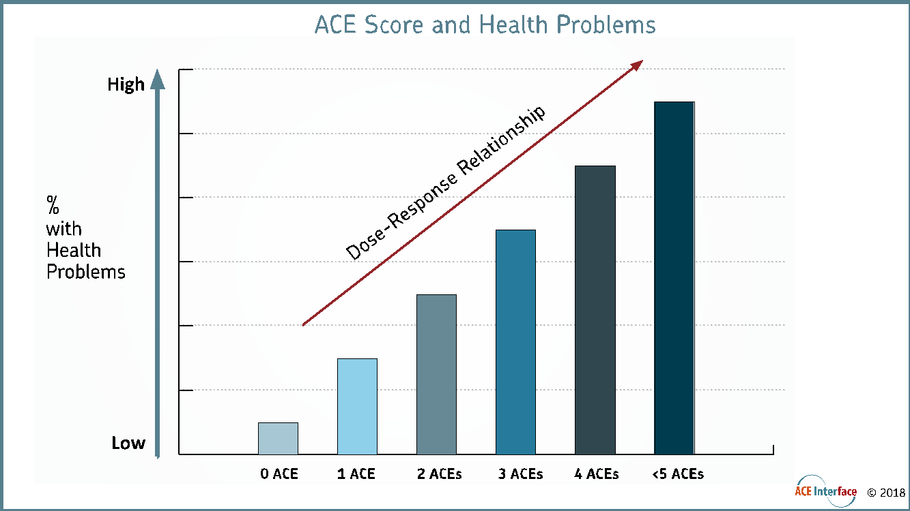
Notes:
Higher ACE score, higher likelihood of condition = dose/response relationship

Slide 24
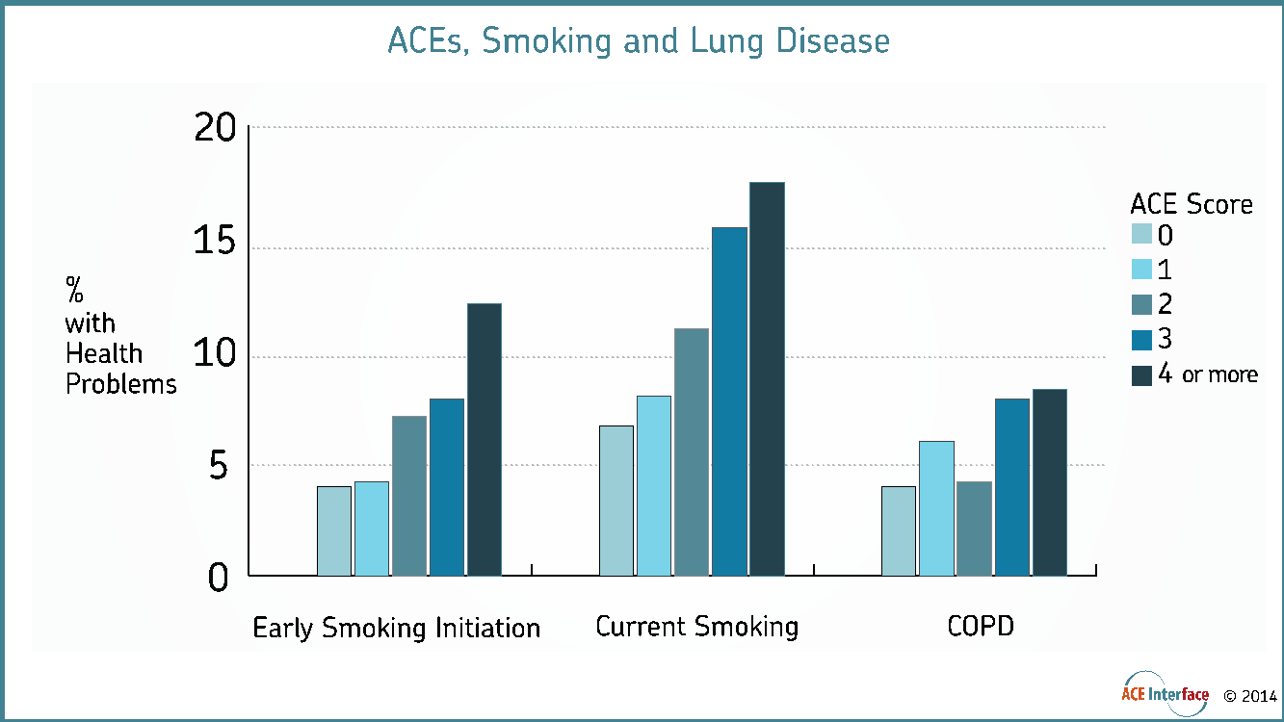
Notes:
The higher the ACE score, te more likely that people smoke as adults.
The stepwise increase in risk of smoking- related issues is dramatic. This should begin to reinforce the idea of the ACE score as a measure of “stress dose”. Dose response… Higher “doses” of ACEs lead to higher “response”; in this case smoking and smoking related disease.

Slide 25
Notes:
ACEs can result in depression and anxiety
Smoking is an adaptive behavior because nicotine can reduce symptoms of depression and anxiety.
ARNECIA
ACEs can result in depression and anxiety.
Smoking is an adaptive behavior because nicotine can reduce symptoms of depression and anxiety.
Nicotine can reduce symptoms of depression and anxiety; so the benefits of nicotine in reducing these unpleasant emotions associated with depression and anxiety might help to explain why knowledge of health risks due to smoking are not enough for some people to quit.

Slide 26
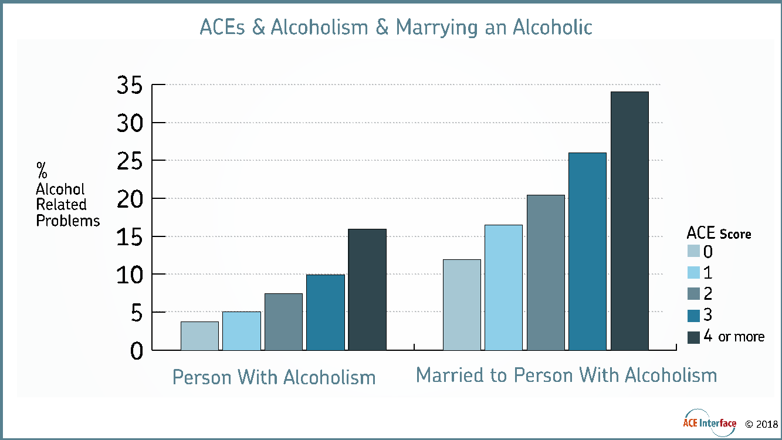
Notes:
The magnitude of the increase in risk of alcoholism as the ACE Score increase is quite large; six-fold risk increases in risk of behaviors or disease are rare in health studies.
The link of ACEs to marriage to an alcoholic is also quite large; and ACEs also increase the risk of marriage to a drug user or intimate partner who is at risk for perpretrating domestic violence. ACEs influence relationships.

Slide 27
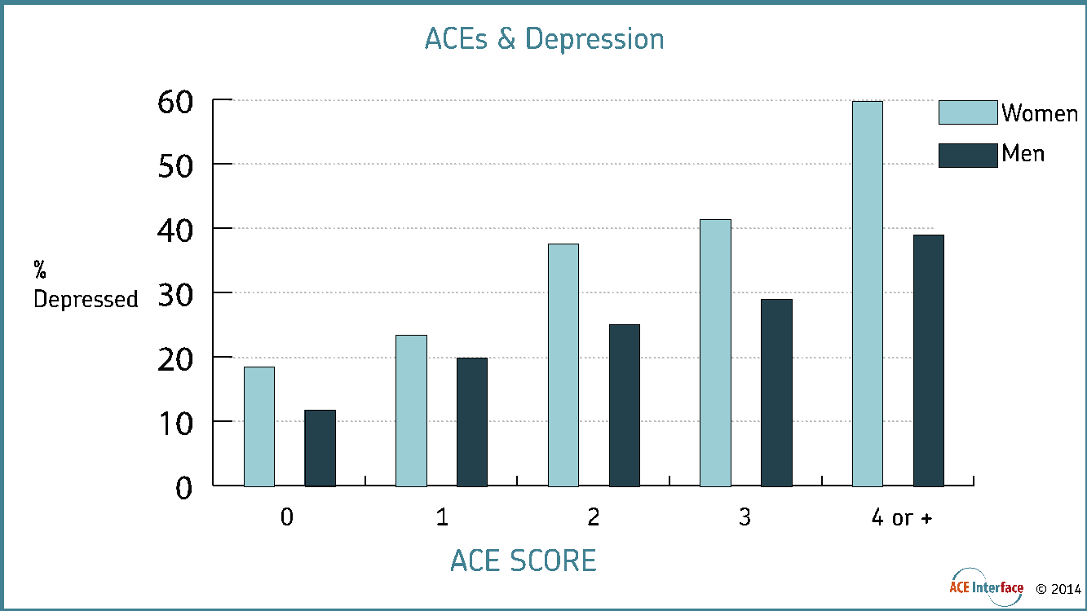
Notes:
The relationship of ACEs to mental illnesses is very strong.
The “adaptations” and behavioral and social problems that tend to result from and co-occur with depression tend to place a large burden on the individual, families, and society.
These ACE consequences are also handed as ACEs for the next generation

Slide 28
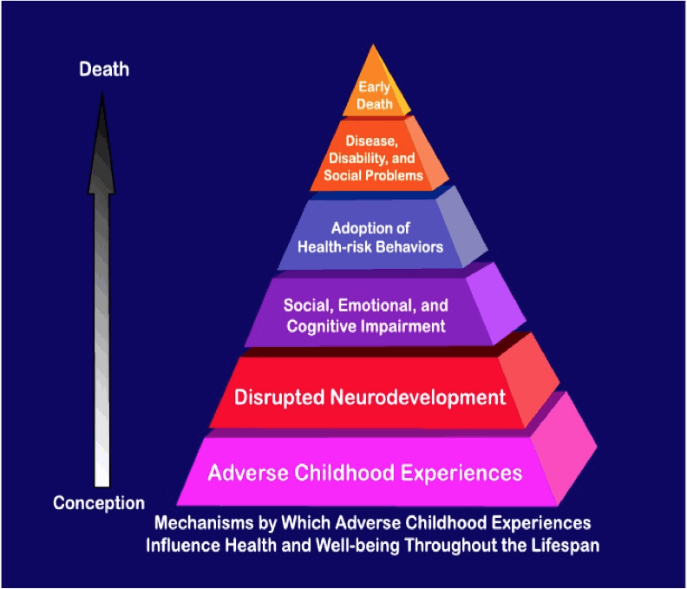
Impact of ACEs
Findings showed that people who experienced four or more adverse childhood events had:
increased risk for smoking, alcoholism and drug abuse
increased risk for depression and suicide attempts
50 or more sexual partners
greater likelihood of sexually transmitted disease
challenges with physical inactivity, and severe obesity
Additional findings show that ACE Score is associated with:
likelihood of attempted suicide across the lifespan
increased risk for broken bones
heart disease
lung disease
liver disease
multiple types of cancer
Notes:
Pair Share: How can we as educators use this information to be agents of change for our students?
As we can see multiple ACE Scores lead to poor outcomes for our students. It is important that we intervene if we want better outcome for our students. They not only negatively impact learning, they also impaired job functioning, homelessness, and criminal justice system.

Slide 29
Notes:
The wide variety of health and social problems that are strongly related to ACEs led the ACE study team to conclude that ACEs are the major public health problem in our nation.

Slide 30
Notes:
ARNECIA
ACEs are Common. ACEs are highly interrelated. ACEs have a cumulative impact that is captured by the ACE Score.
And… People with higher ACE Scores are more likely to have multiple health and social problems, some of which increase the odds of their children having high ACE scores.
ACE Study findings present a strong case for concluding that the relationship between the ACE Score and health problems is a “cause and effect” relationship.

Slide 31
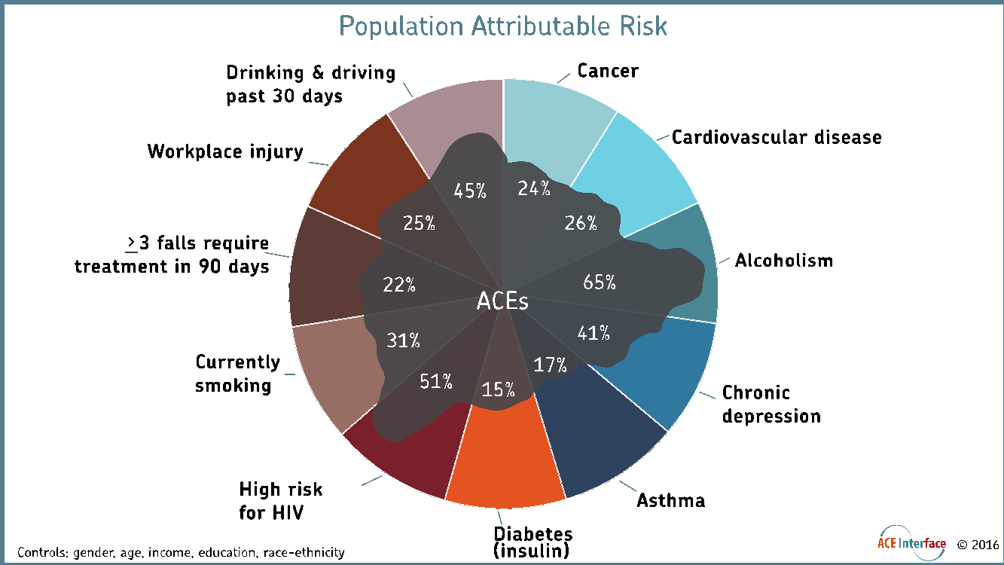
Notes:
When we prevent ACEs we reduce many other problems simultaneously.
A large proportion of many health and social problems can be prevented by reducing ACEs

Slide 32
Understanding trauma and its impact
What is trauma
Understanding the different types of trauma
Acute Trauma
Complex Trauma
What is an acute trauma response
Fight, flight or freeze
Notes:
Arnecia
There are other types of trauma but we will only be focusing on these two types today because these two are the most prevalent in schools.

Slide 33
Traumatic Experiences are Prevalent in the Lives of Children
One out of every four children attending school has been exposed to a traumatic event that can affect learning and behavior
Trauma can impact school performance and impair learning
Traumatized children may experience physical and emotional distress
The National Child Traumatic Stress Network, 2017
Notes:
Arnecia
Instances such as exposure to violence, child, abuse and neglect, living with a parent with mental illness and substance abusing parents.

Slide 34
Why Trauma Sensitive Schools
21st Century schools must learn to recognize the impact of trauma on students
To:
Foster safe and supportive learning environments
Build an environment where students can make positive connections
Teach students how to safely regulate their emotions and heal from the impact of trauma
Adapted from www.traumasensitiveschools.org
Notes:
Arnecia

Slide 35
Trauma-Sensitive Schools
Assume that everyone has had experiences that could be traumatizing; such as a history of abuse or neglect, or mental health issues and exposure to violence. Therefore, we as educators want to be thoughtful about how we navigate interactions with students.
The National Child Traumatic Stress Network
Notes:
John
The National Child Traumatic Stress Network

Slide 36
Notes:
Simple tools that help people reflect on their own emotional state are helpful
Willingness to wait until everyone is able to have rational conversation (not ramped up in an emotional state) produces better accountability.
We are the ones who are developing important accommodations based on emerging basic science findings

Slide 37
Notes:
ARNECIA
The ACE Study invites our ideas and innovation –the science is too new to have a roadmap!!!
The ACE study provides us with straight-forward information about the consequences of toxic stress during childhood.
This scientific research gives us powerful information we can use every day to improve health, safety, prosperity and longevity. But the ACE study isn’t a detailed roadmap of services or programs; it is an invitation for us to be pioneers.
The science is too new to have a roadmap already in place.

Slide 38
Notes:
John
People are motivated by learning about resilience.
We build resilience through three protective systems: capabilities, belonging, community-faith-culture
People are most likely to become resilient when they live in thriving families and communities

Slide 39
Notes:
Relationships with people who care and have competencies for relating to our inner strengths and gifts are important contributors to resilience
Beware of oversimplification; we need to build emotional and relational competencies in addition to caring.

Slide 40
Notes:
Resilient communities are empowered communities- they learn, manage, and improve their own quality of life.
Supporting community resilience requires respect for community efficacy.
Public and private partners that foster thriving communities learn from those communities and celebrate exceptional results from their work

Slide 41
Notes:
High capacity communities systematically use a four phase process for engaging everyone in child, family and community betterment
Those phases are: come together around issues that matter, learning together, making decisions based on the world we want for our future, and making room for everyone to co-lead community efforts.

Slide 42
Notes:
ARNECIA
Building community capacity is a high leverage investment – it improves population-level results.
People living in high capacity communities are less likely to have high Adverse Childhood Experience scores, less drug and alcohol abuse, less depression and serious and persistent mental illness, and fewer problems in school and at work.

Slide 43
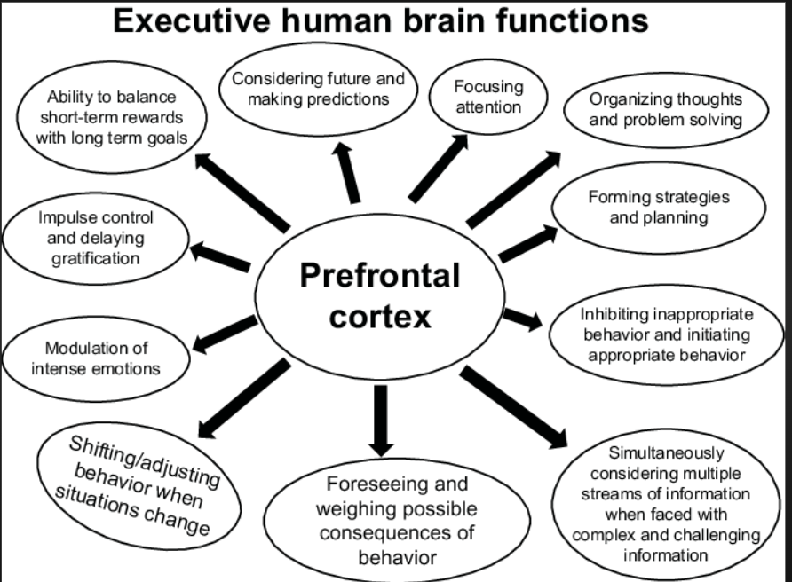

Slide 44
Reflection Questions
What is the role of schools in supporting students who are experiencing trauma?
Notes:
Arnecia-Table Talk

Slide 45
Reflection Question
How is your school district supporting staff to meet the needs of students exposed to trauma?
Notes:
John
Table Talk…..Asked for Volunteer

Slide 46
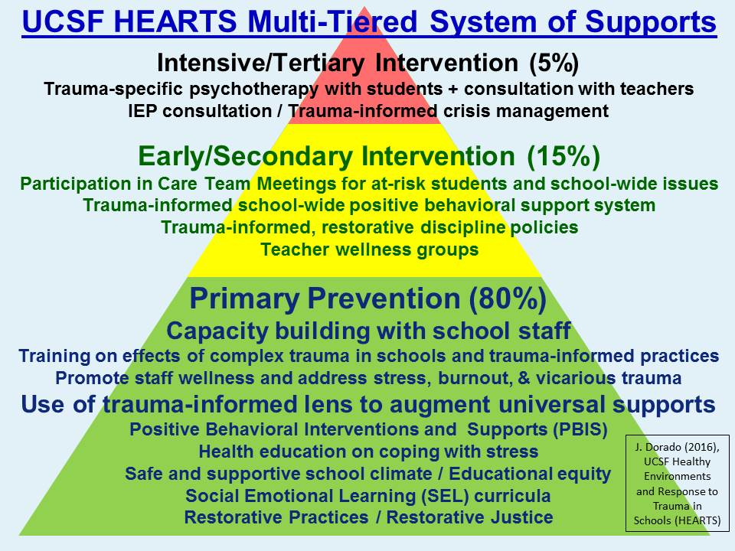
Notes:
University of California, San Francisco

Slide 47
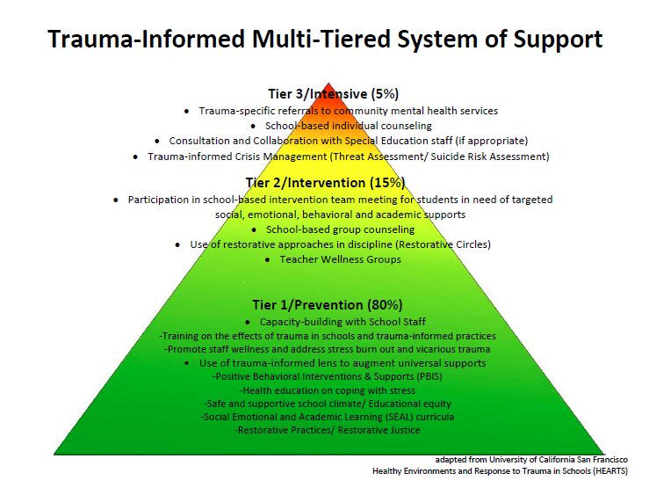
Notes:
Arnecia

Slide 48
Addressing Trauma in Schools
Addressing Trauma in Schools
Notes:
Arnecia

Slide 49
Trauma Informed School Practices
Aim to:
Understand, recognize, and respond to the effects of all types of trauma.
Avoid re-victimization.
Appreciate that many problem behaviors began as understandable attempts to cope.
Maximize choices to improve student behavior and create a safe place for learning and healing.
Safe Supportive Learning
https://safesupportivelearning.ed.gov/
Notes:
Arnecia
Notes Discuss ways we can develop Trauma sensitive schools?

Slide 50
Trauma Informed School Practices cont.
Aim to:
Be culturally competent.
Understand student behavior in the context of their life experiences and cultural background.
Emphasize physical, psychological and emotional safety for students and staff.
Understand that students who are exposed to trauma are sometimes mistaken as bad and as having learning disabilities.
Safe Supportive Learning
https://safesupportivelearning.ed.gov/
Notes:
John
Building Supportive Relationships
Creating Safe Spaces
Supporting Prosocial Behavior
Building Resilience
Mindful Awareness
Cultivating Compassion in the Classroom

Slide 51
Trauma informed teachers have a paradigm shift and change their conversation and language.
Notes:
John
Researchers explain that when we believe an individual has complete control over his or her behavior, we are more likely to be angry when that behavior is inappropriate. But if we recognize the factors that shape a child’s behavior and compromise self-control, we are more likely to attempt to ease the child’s plight.

Slide 52
Notes:
John
The speaker-presenter role is vital to success
Telling everyone in ways that evoke new ways of thinking and new action is always at the foundation of transformational change
Transformational changes happens when people change the way they relate day-by-day with another - “We are the ones we have been waiting for” Hopi Elder

Slide 53
Notes:
What is predictable is preventable. What we do MATTERS

Slide 54
Resources
“Reaching and Teaching Children Who Hurt: Strategies for Your Classroom”
by Susan E. Craig

